Slide 1
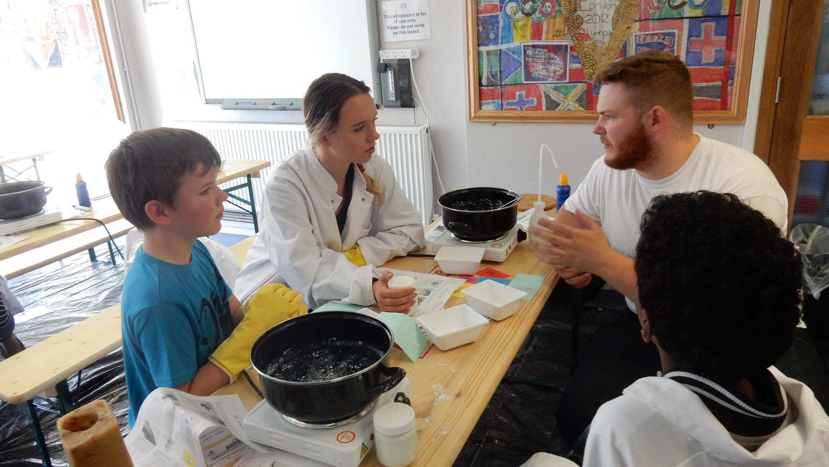
Citizen Science – from the margins to the mainstream?
Dr Muki Haklay –
Professor of Geographical Information Science, UCL
Team lead, Citizen Science,
Learning Planet Institute/Université Paris Cité

Slide 2
Overview
Early awareness and development of citizen science in Europe
Current development and support
Challenges to mainstreaming
Opportunities for change?
Providing training and culture change support

Slide 3
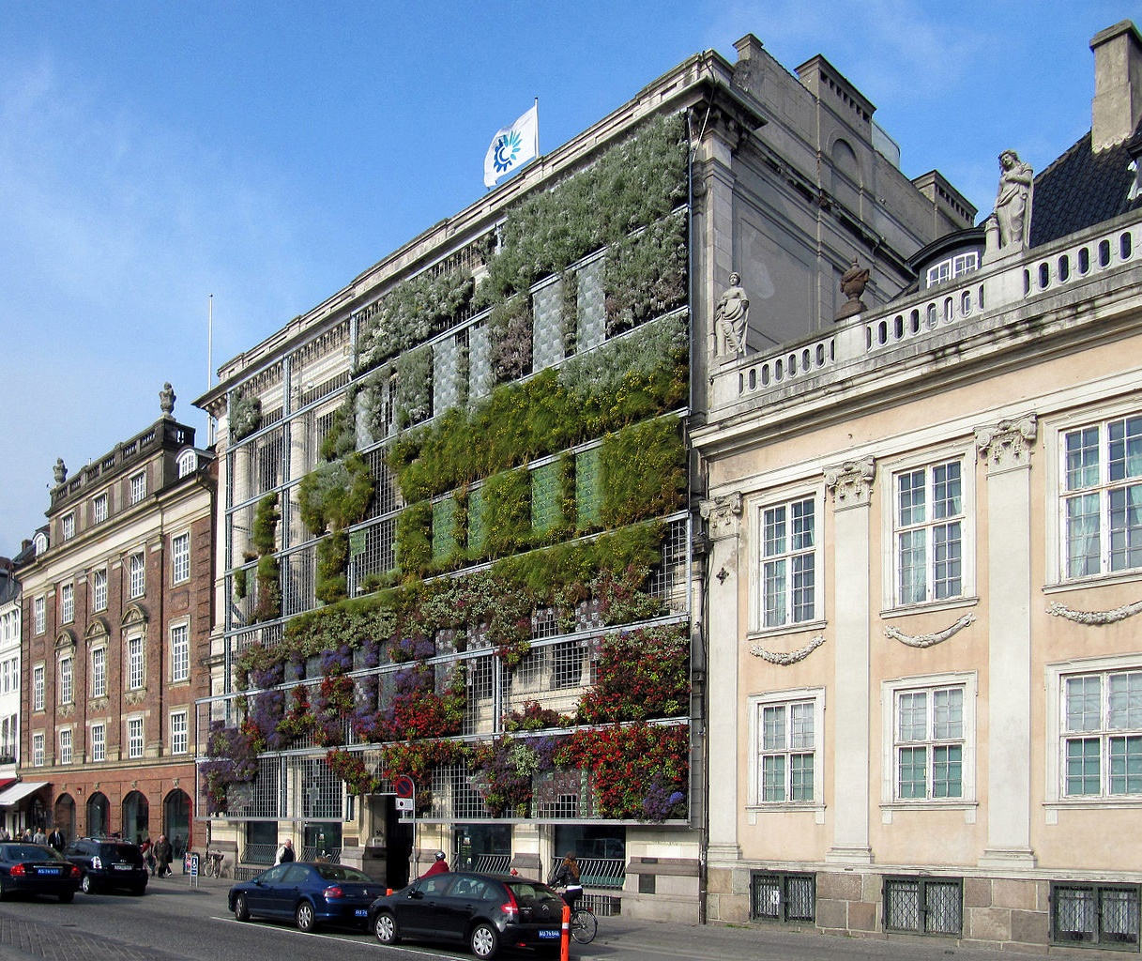
European context
Discover, collaborate, explore: From theory to practice

Slide 4
Citizen Science as Gentlemen/ Gentlewomen science
Citizen science diminishing / marginalised
Citizen Science – part of open & inclusive science
Illiteracy
Basic to
High-school
Higher Education
Early science
(1600’s – early 1800’s)
Professional science
(late 1800’s – 1900’s)
Opening Science
(since 2000’s)
Notes:
We are now entering the current state of science and citizen science, in which we’re seeing citizen science gain recognition in research and policy, and we also see growth in organisations and activities – we will cover them soon. However, the question that we will explore is why do we see it now?

Slide 5
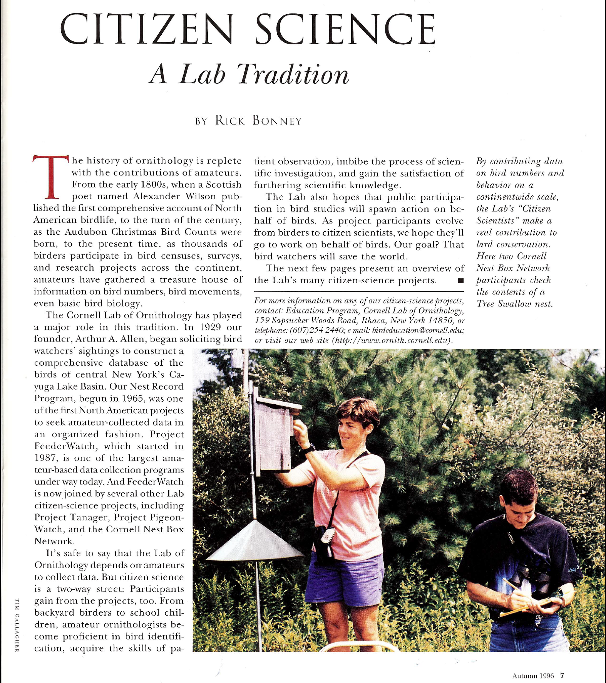
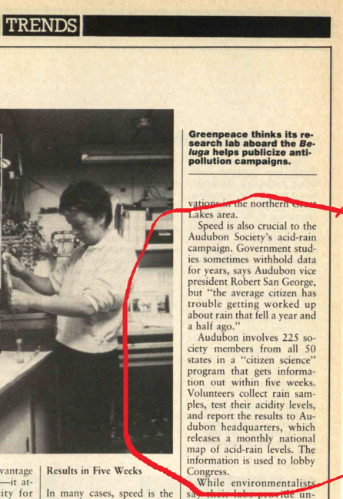
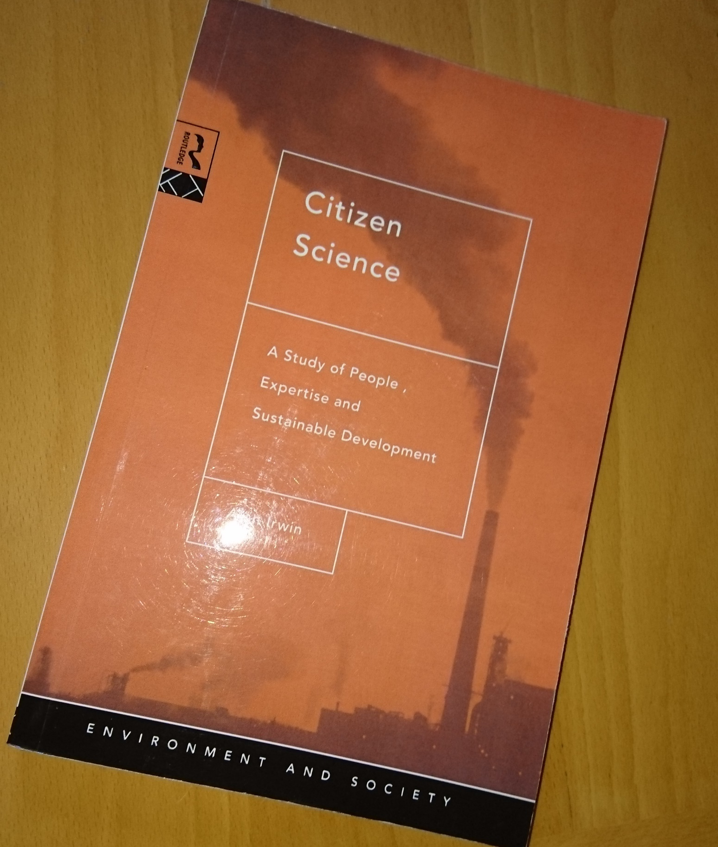
Mid 1990s – citizen science emerge
MIT Technology Review 1989
Living Bird, 1996
Notes:
In the 1990s, the term citizen science started to appear and being used to describe the type of activities that today we include in the term. Probably the most prominent are the book by Alan Irwin with this name, which came out of work that focused on public understanding of science and the need to link science and society, which we will cover at a later part of the course, and the definition by Rick Bonney, which is more focused on sharing observations of nature and engaging amateurs in scientific projects. However, it would take until the late 2000s when citizen science eventually took off as a term and different practices that use a range of names and terminology coalesced around it.

Slide 6
Early recognition of citizen science by environmental information authorities
Prof. Jacquie McGlade, head of European Environment Agency, 2008 (Aarhus + 10):
‘Often the best information comes from those who are closest to it, and it is important we harness this local knowledge if we are to tackle climate change adequately… people are encouraged to give their own opinion on the quality of the beach and water, to supplement the official information.’

Slide 7
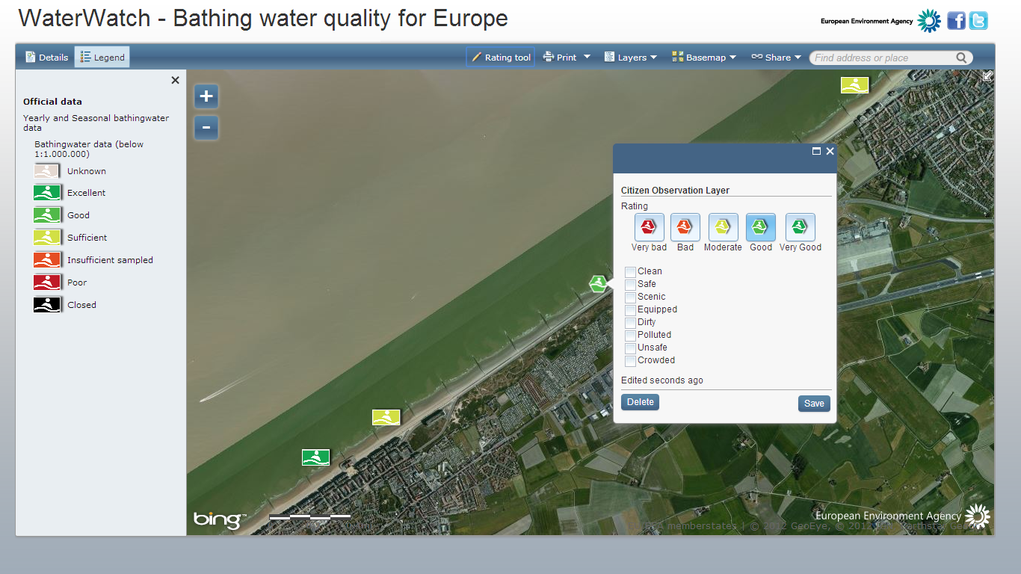
EEA WaterWatch

Slide 8
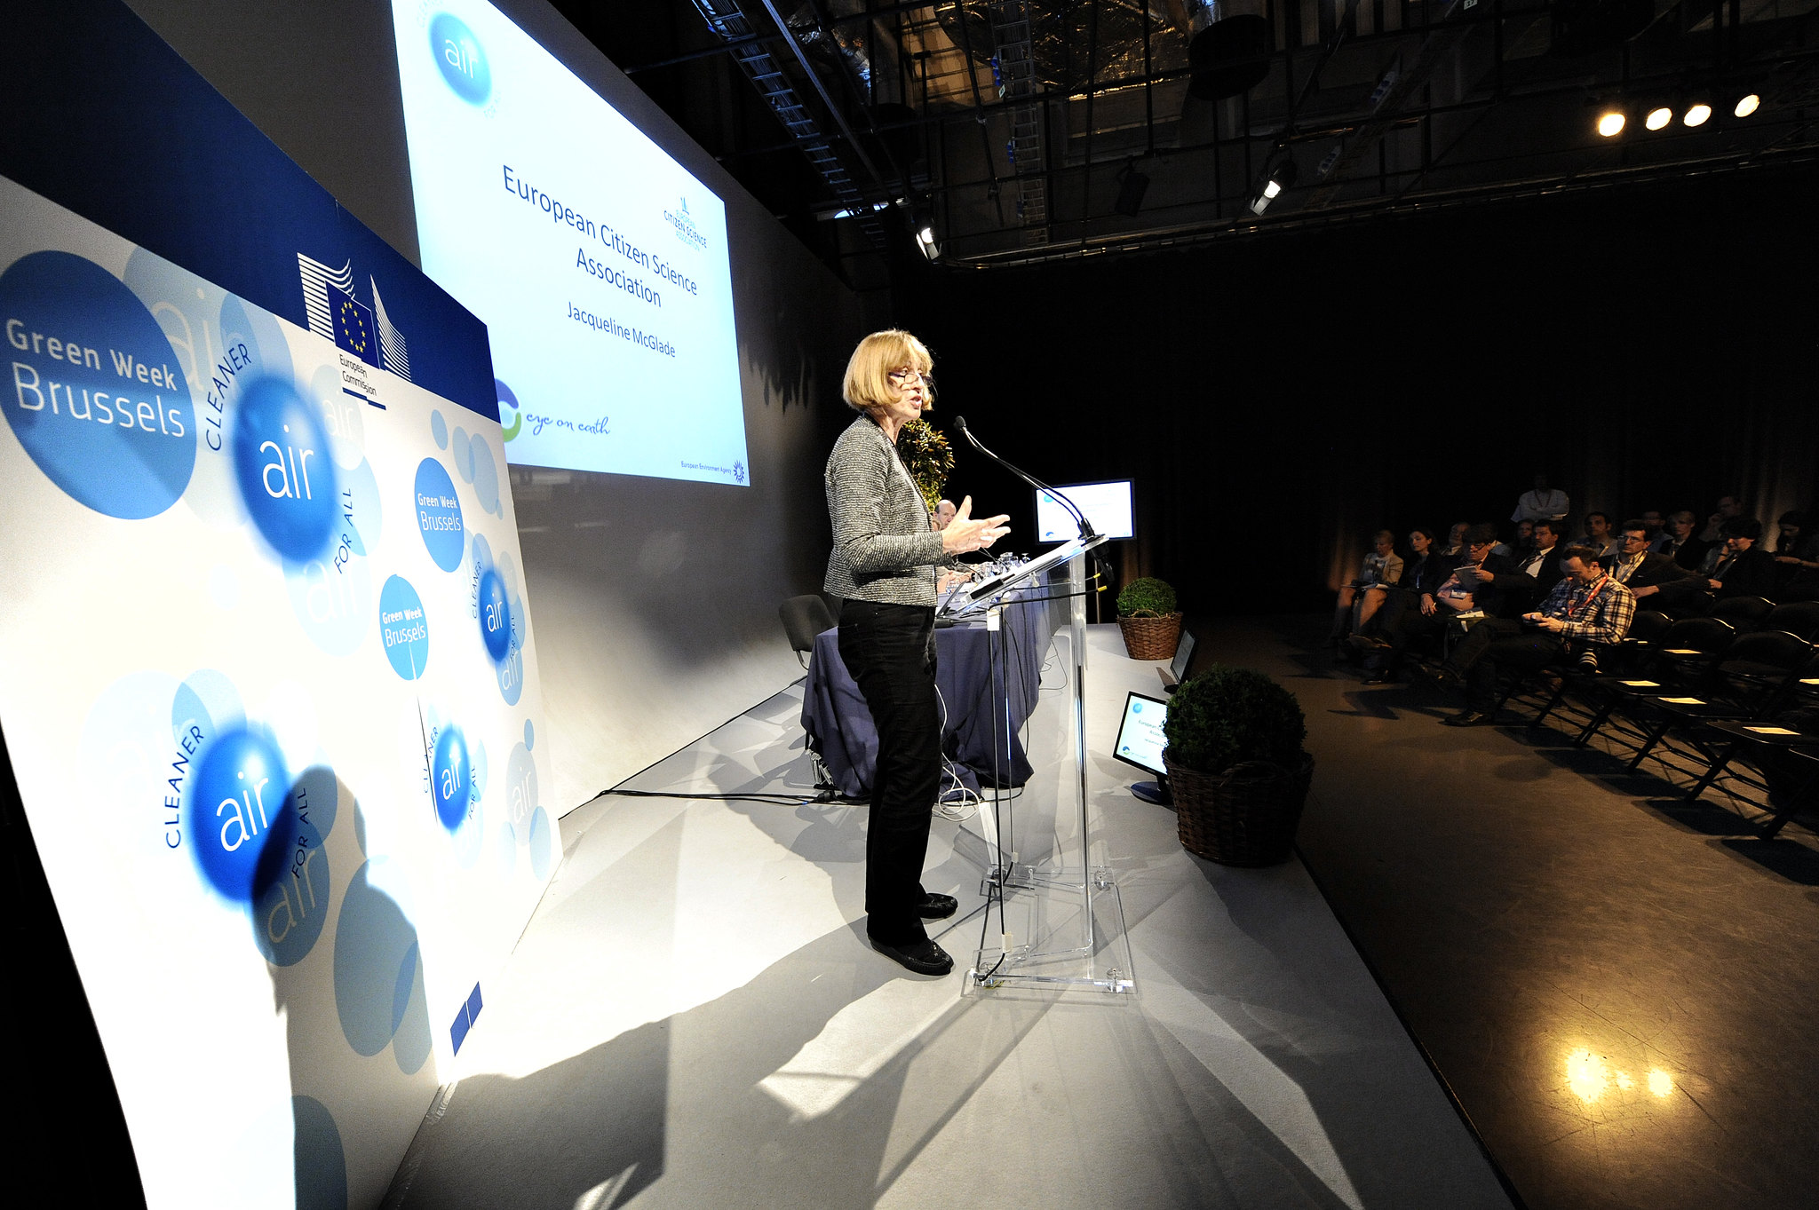
European Citizen Science Association
Following a large, nationwide project in the UK (Open Air Laboratories), ECSA was launch in 2013 to achieve European-wide impact
Based in Berlin, at the Museum of Natural History
Brussels , Belgium , 06 June 2013 - Green Week 2013 - Evening Session - Launch of the European Citizen Science Association (ESCA) and discussion on its aims and objectives with interactive displays of best examples of Citizen Science Programmes in the EU - Prof. Jacqueline McGlade , Member of the International Resource Panel © EU - Patrick Mascart

Slide 9

ECSA 10 principles
ECSA 10 Principles of Citizen Science
Citizen science projects actively involve citizens in scientific endeavour that generates new knowledge or understanding.
Citizen science projects have a genuine science outcome.
Both the professional scientists and the citizen scientists benefit from taking part.
Citizen scientists may, if they wish, participate in multiple stages of the scientific process.
Citizen scientists receive feedback from the project.
Citizen science is considered a research approach like any other, with limitations and biases that should be considered and controlled for.
Citizen science project data and meta-data are made publicly available and where possible, results are published in an open access format.
Citizen scientists are acknowledged in project results and publications.
Citizen science programmes are evaluated for their scientific output, data quality, participant experience and wider societal or policy impact.
The leaders of citizen science projects take into consideration legal and ethical issues surrounding copyright, intellectual property, data sharing agreements, confidentiality, attribution, and the environmental impact of any activities.
Notes:
As we noted, ethical practices are happening inside a community of people. Many times, ethical guidelines are related to a profession (e.g. for civil engineering, or for medical practitioners). However, in communities of practice – a group of people who share values and focus on working in the same area – it is also possible to see ethical guidelines. In our case, we are focusing on the people who are involved in running citizen science projects. Here is an example from an early stage in the development of the European Citizen Science Association, which we will look at in more details in the lecture about organisations and policy, but for now we can point to it as the body that brings together practitioners of citizen science from across Europe and beyond. One of the working groups, which started discussing best practices and standards, was led by Lucy Robinson from the Natural History Museum in London. The group decide to describe these aspects as 10 principles. The principles were suggested in 2014, and then became part of the guidelines of ECSA in 2015. If we look through them, we see that they are including ethical guidance for citizen science projects. Principle 1 and 2 are about what should be included in a project in order to define it as citizen science, but after that, the other principles are about the ethics – what is the right thing to do in a citizen science project: provide feedback to participants, share the data, get credit and so on. You can identify some aspects which are general scientific ethics (using the methodology appropriately) and other principles that are included because of the need for specific attention to the characteristics of citizen science.

Slide 10
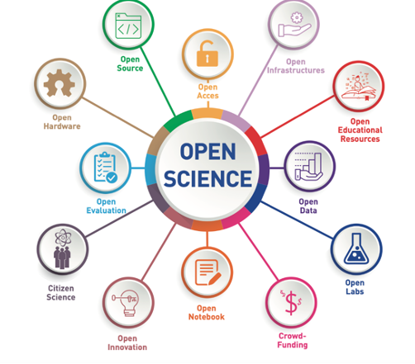
Fast forward - current practice developments
Discover, collaborate, explore: From theory to practice

Slide 11
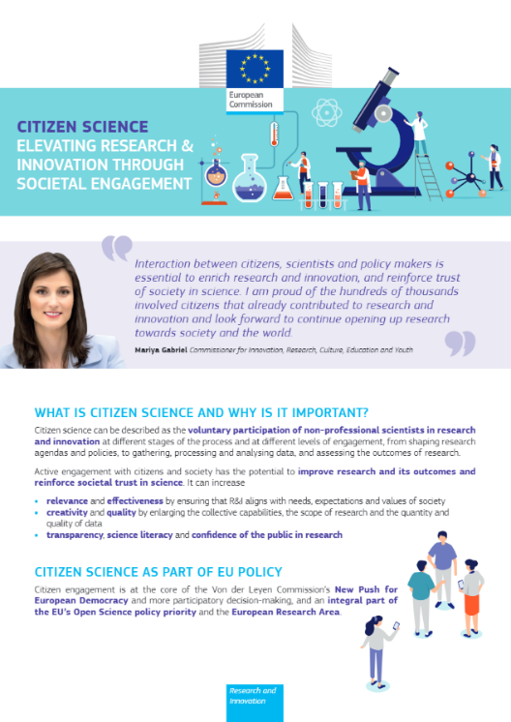
Endorsing citizen science
Citizen Science is part of Open Science in the EU policy framing.
“citizen science can be described as the voluntary participation of non-professional scientists in research and innovation at different stages of the process and at different levels of engagement, from shaping research agendas and policies, to gathering, processing and analysing data, and assessing the outcomes of research.” (Citizen Science factsheet 2020)

Slide 12
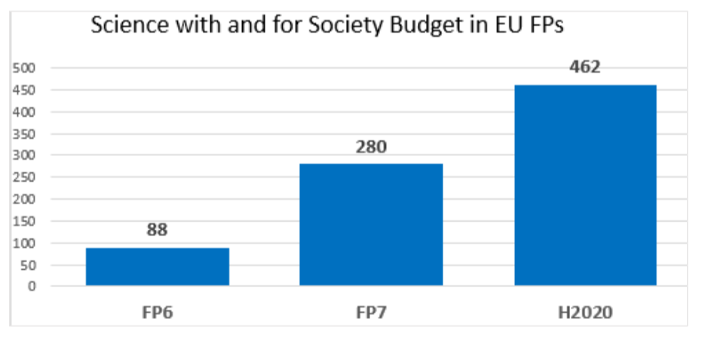
European Commission: Directorate-General for Research and Innovation, Warin, C., Delaney, N. and Tornasi, Z., Citizen science and citizen engagement – Achievements in Horizon 2020 and recommendations on the way forward, Delaney, N.(editor) and Tornasi, Z.(editor), Publications Office, 2020, https://data.europa.eu/doi/10.2777/05286

Slide 13
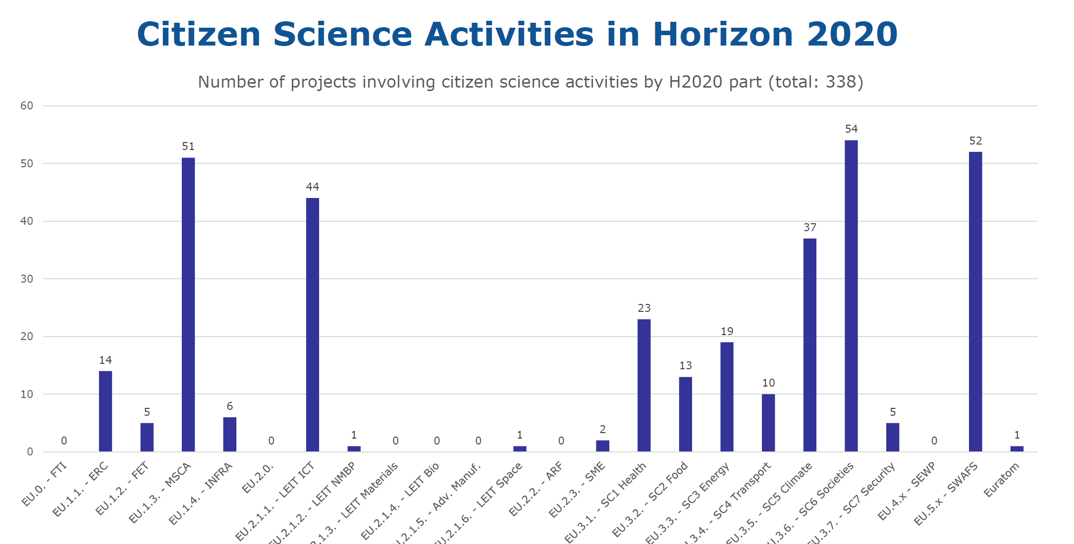
Source: Michael Arntoft DG R&I Open Science

Slide 14
Horizon Europe legal texts
Reg. - Recital (26): ...the Programme should engage and involve citizens and civil society organisations in co-designing and co-creating responsible research and innovation (RRI) agendas and contents that meet citizens' and civil society's concerns, needs and expectations...
Reg. - Programme principle (A6a.8): The programme shall promote co-creation and co-design through engagement of citizens and civil society
SP - Operational objectives (A2.2): (c) promoting responsible research and innovation, taking into account the precautionary principle; (n) Improving the relationship and interaction between science and society, including the visibility of science in society and science communication, and promoting the involvement of citizens and end-users in co-design and co-creation processes
Open Science, which includes citizen and societal engagement, will be operationalised throughout the programme: award criteria for proposal evaluation, key impact pathways, and within topic texts

Slide 15
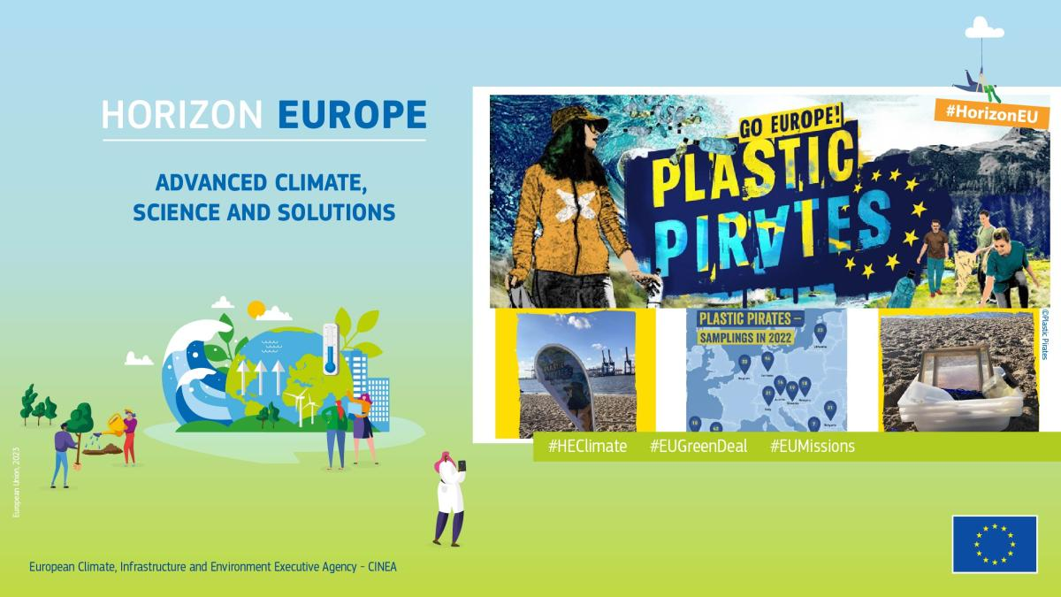

Slide 16
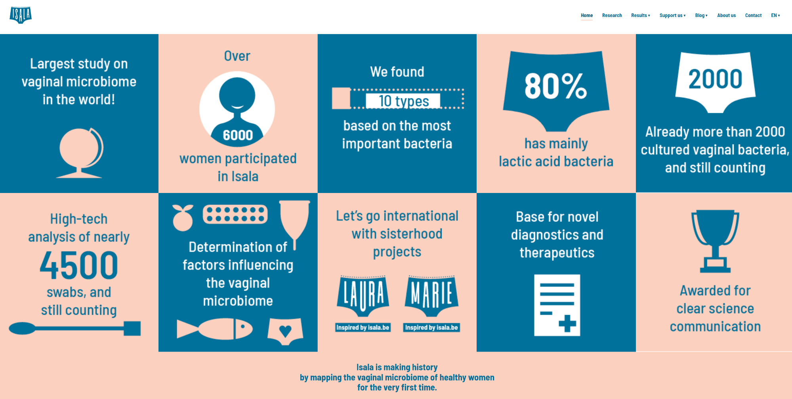
ISALA – citizen science in frontiers science
Notes:
Sarah Lebeer is a professor, microbiologist, bioengineer and the principal investigator of the Isala project. She has been studying the potential of lactobacilli for over 15 years. At the University of Antwerp, she leads the lab of Applied Microbiology and Biotechnology since 2012. Here, several techniques from molecular microbiology and bacterial genetics are combined with functional, microbiome analysis and citizen-science.

Slide 17
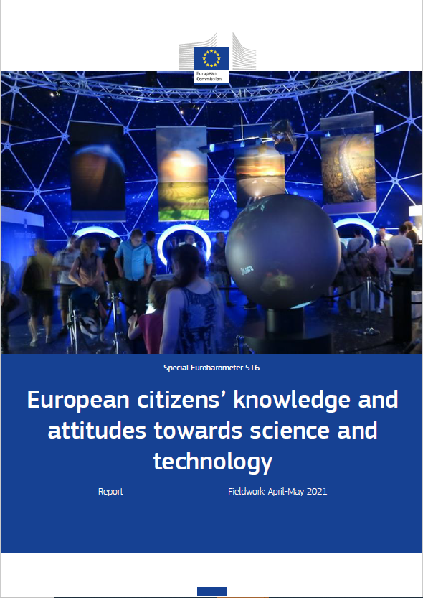
Public engagement evidence - Eurobarometer 516
Fieldwork:13 April and 10 May 2021
Sample size: 37,103 respondents (26,827 from the EU27)
66 ‘question units’ + demographic
Questions on knowledge, the impacts and governance of science and technology, views of scientists, citizen engagement in S&T, young people, gender equality, and social responsibility, and comparative advantage of the EU
https://europa.eu/eurobarometer/surveys/detail/2237

Slide 18
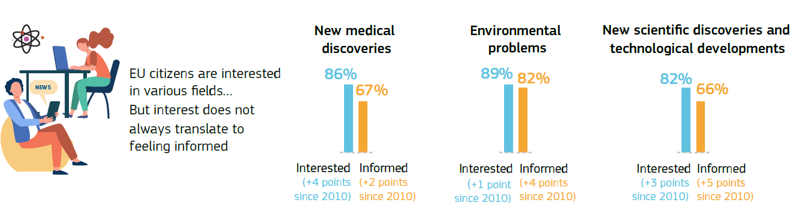
A high level of interest in science
Source: Special Eurobarometer 516 – “European citizens’ knowledge and attitudes towards science and technology”. Fieldwork: April – May 2021, sample: EU27 data (26,827 respondents)

Slide 19
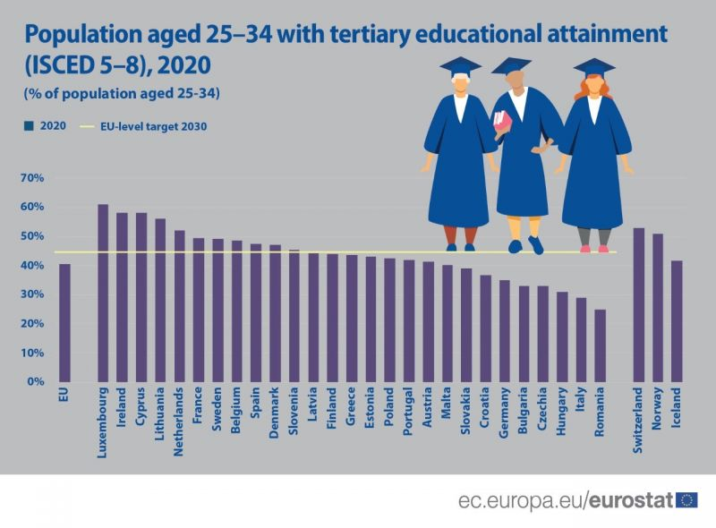

Slide 20

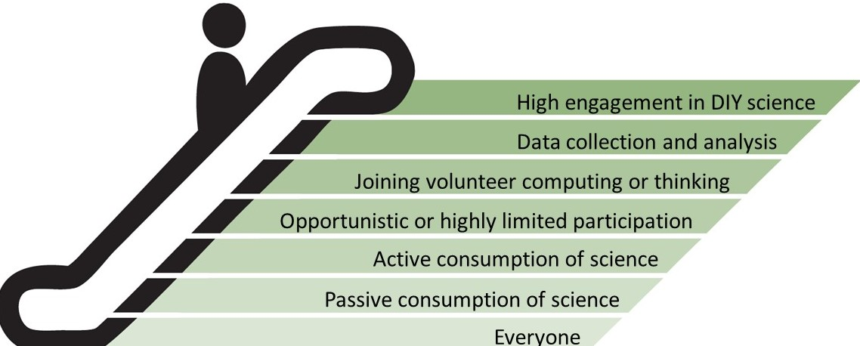
Citizen Science with public engagement
This project has received funding from the European Union’s Horizon 2020 research and innovation programme under grant agreement No 709443

Slide 21
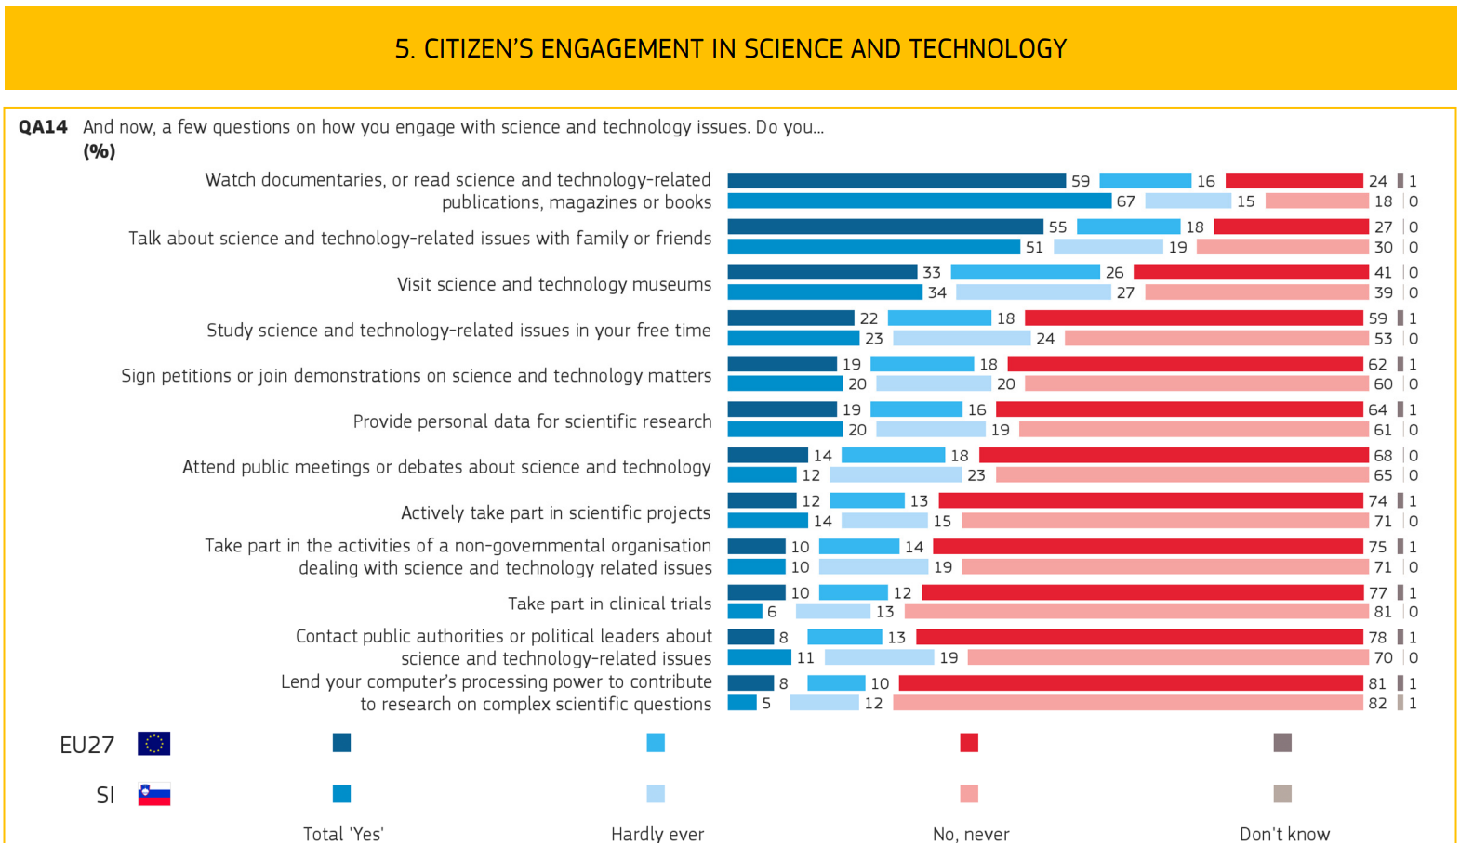

Slide 22
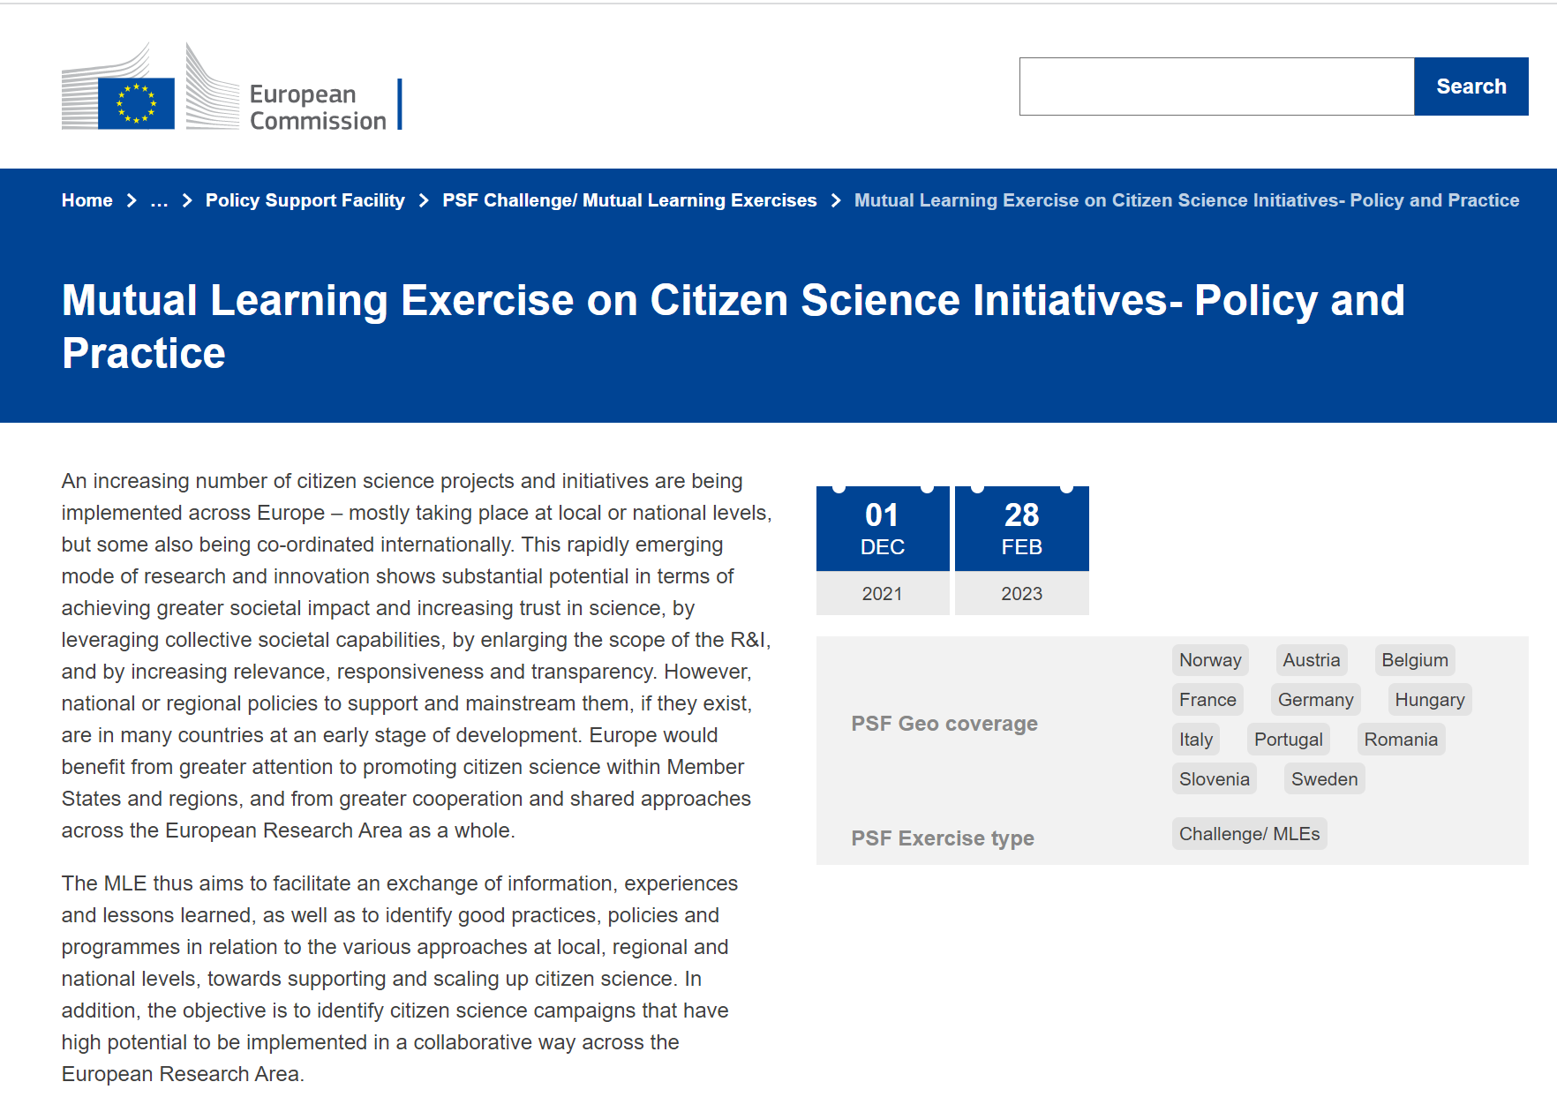
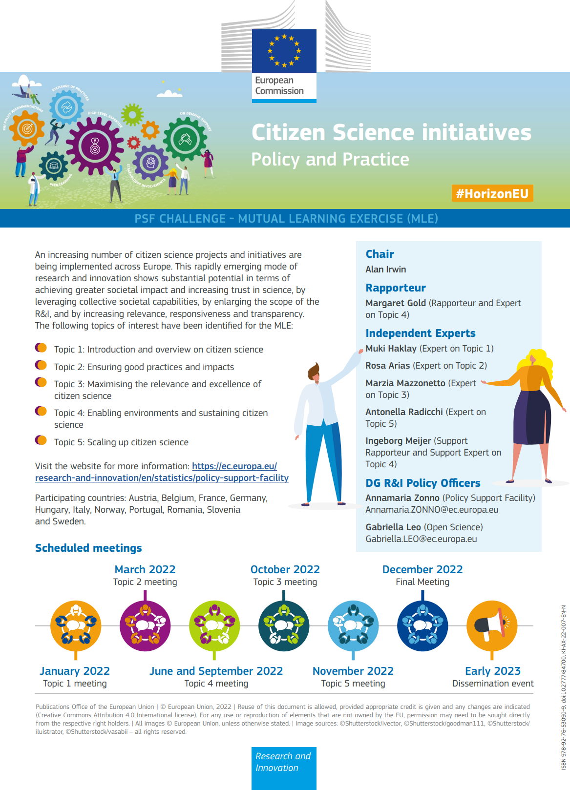
2022
Notes:
At the EU level, throughout 2022 and at the beginning of 2023, 11 member-state carried out a Mutual Learning Exercise on citizen science policies and initiatives. The study covered in depth environmental citizen science in Belgium, Germany, Austria, and Slovenia. The exercise produced 5 reports that can help signatories to the convention to identify opportunities to integrate citizen science within their research and innovation and environmental monitoring practices https://ec.europa.eu/research-and-innovation/en/statistics/policy-support-facility/psf-challenge/mutual-learning-exercise-citizen-science-initiatives-policy-and-practice

Slide 23
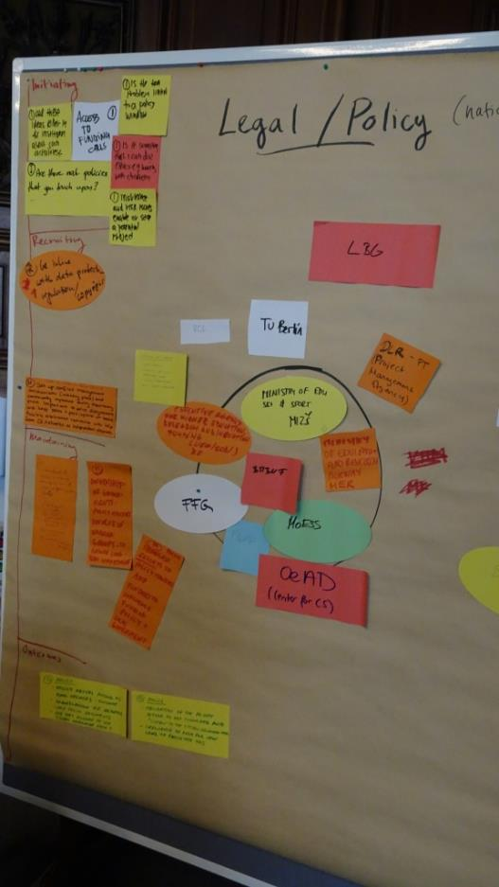
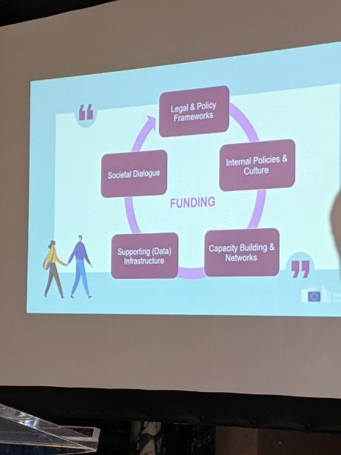
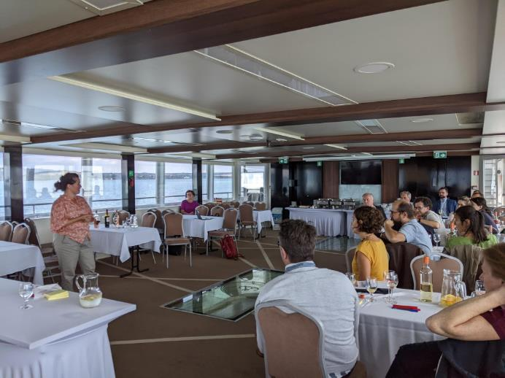
MLE process
Year long process
Many member states involved
Site visits and in depth discussions
Exchanging experience and mutual support

Slide 24
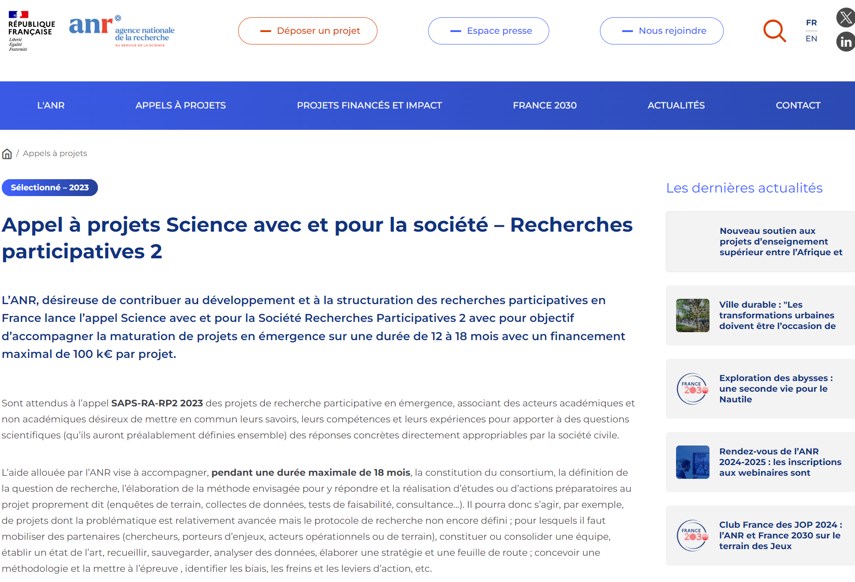
Outcomes
Funding programme in Romania
Network in Slovenia
Federal network of citizen science projects in Belgium
Linking policy makers and funders in different countries
New programme in the Netherlands (which wasn’t part of the network)

Slide 25
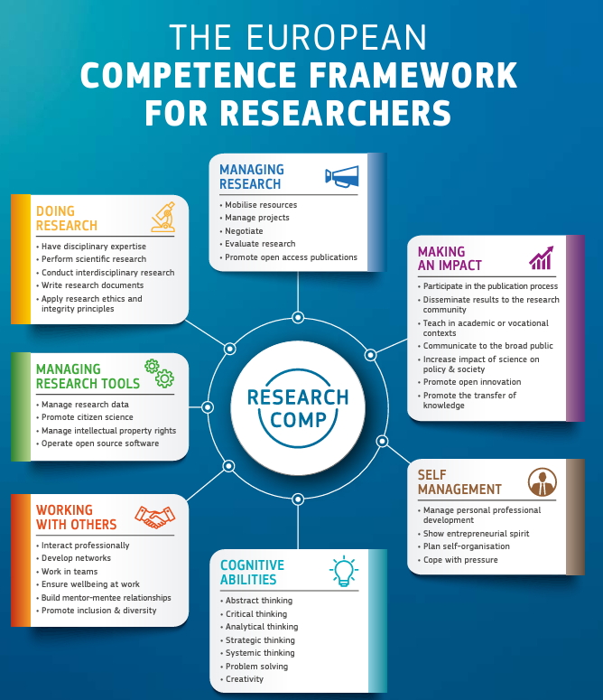
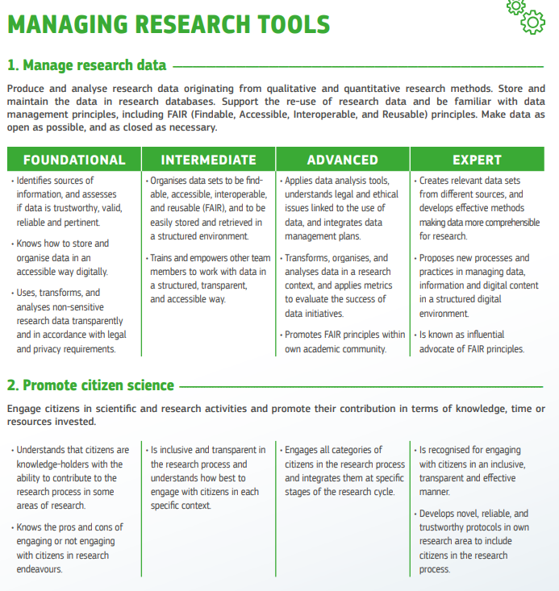

Slide 26
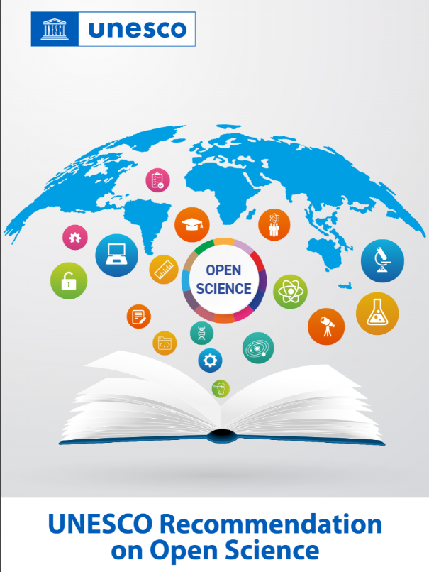
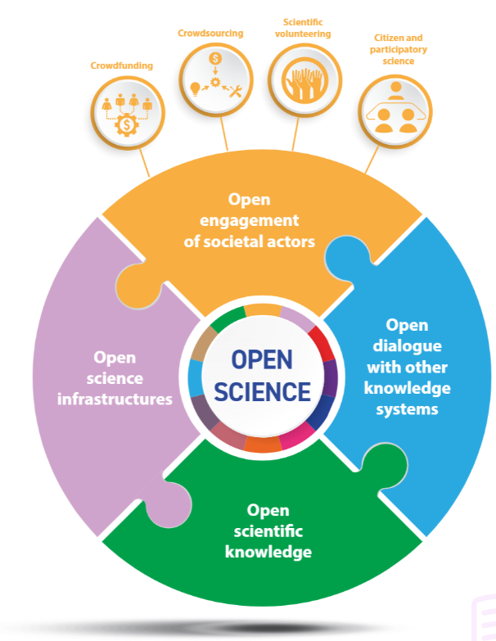
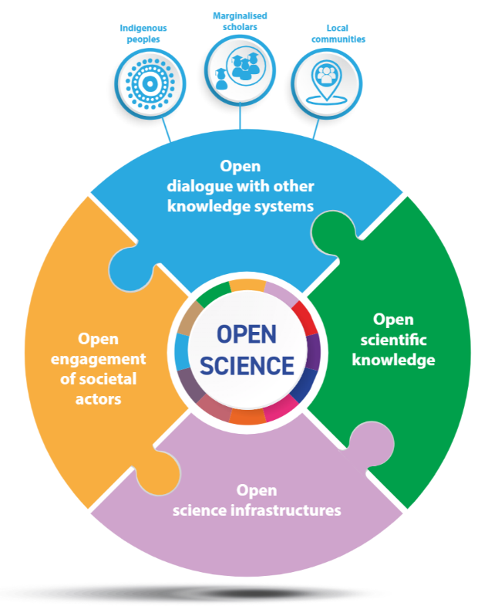

UNESCO Recommendation on Open Science

Slide 27
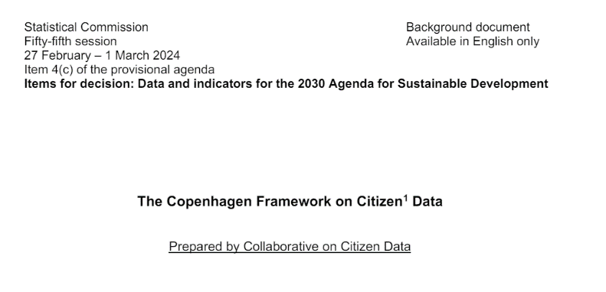
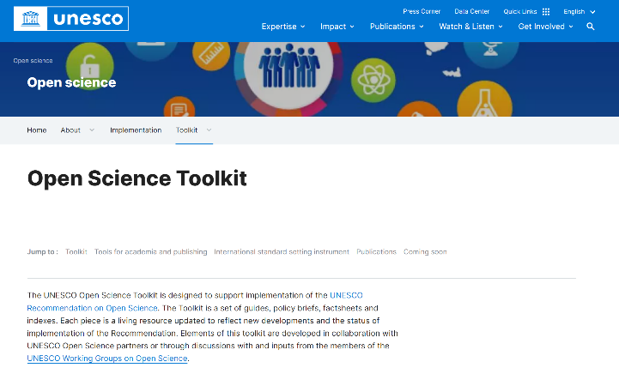

Current policy push
UNESCO recommendations – toolkit and expectations of implementations,
OECD working group and report on R&I support to citizen science
UN statistical office support for Citizen Generated Data (Copenhagen framework)
Notes:
Ecological observations (also called biological observations in the UK), with people reporting seeing plants, fungi, and animals, is a very long running activity. There are many such projects – a review in 2012 identified over 230 projects in the UK. A good example for this is a Big Garden Birdwatch – a mass participation project run by the Royal Society for the Protection of Birds (RSPB) and engaging over half a million people to spend one hour, on a weekend, at the end of January, looking to the garden and reporting on the birds that they see. “A long-running citizen science project, the strengths of Big Garden Birdwatch are more obvious on engagement and communication aspects than they are on science. This activity involves an extremely large number of people, many of whom would not class themselves as birdwatchers but are encouraged to watch the familiar birds in their garden for an hour. This raises awareness and, through this engagement, allows the RSPB to build more support for conservation. The release of the results to the media provides the RSPB with its largest media story each year – thereby reaching more people.” (Dr Mark Eaton, RSPB)
In 2021, during a period of lockdown due to the Covid-19 pandemic, over million people participated in the survey

Slide 28
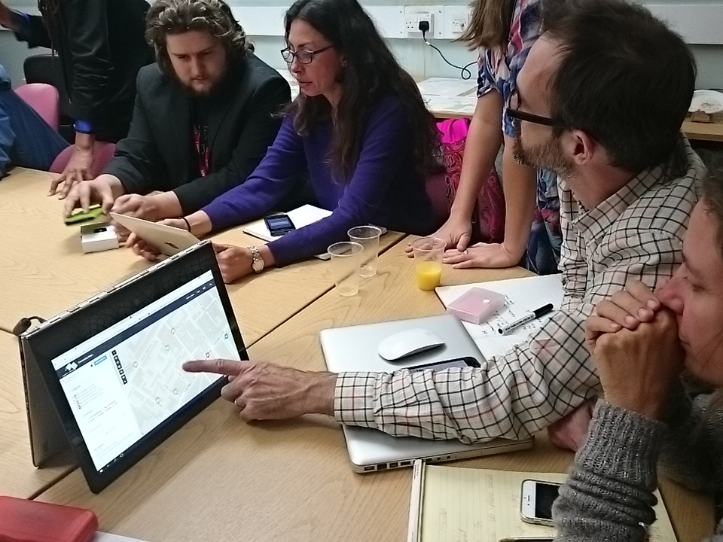
Challenges and opportunities
Discover, collaborate, explore: From theory to practice

Slide 29

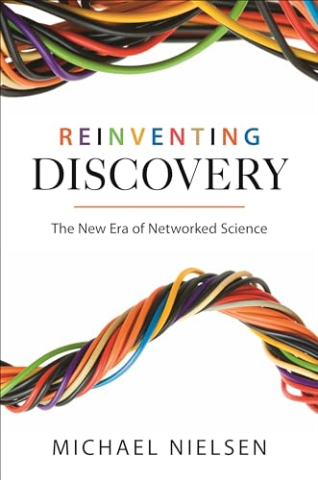
Citizen Science & Open Science
Michael Nielsen (2011) Reinventing Discovery
Science as an open enterprise (2012)
Both mention citizen science

Slide 30
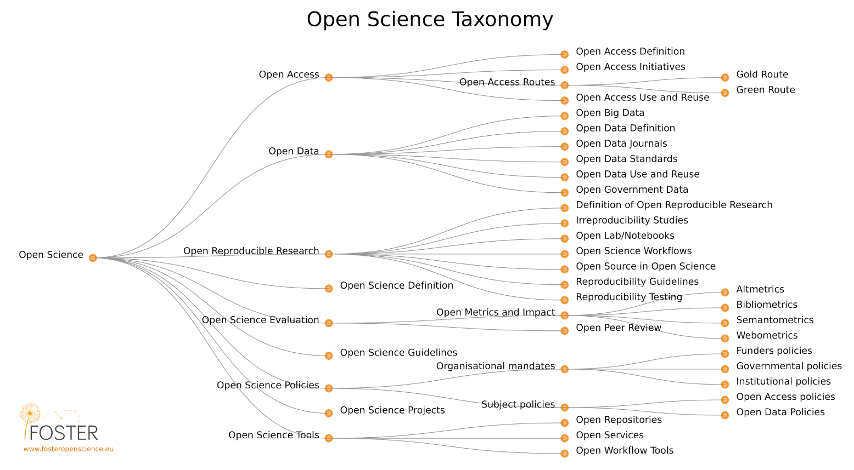

Slide 31
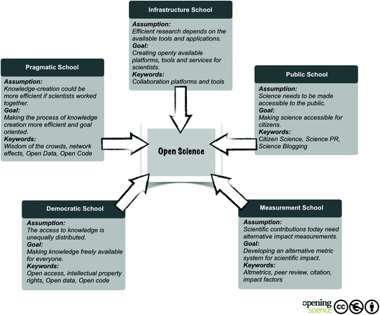
Open science “schools” and components
Bartling and Friesike Opening Science 2014

Slide 32
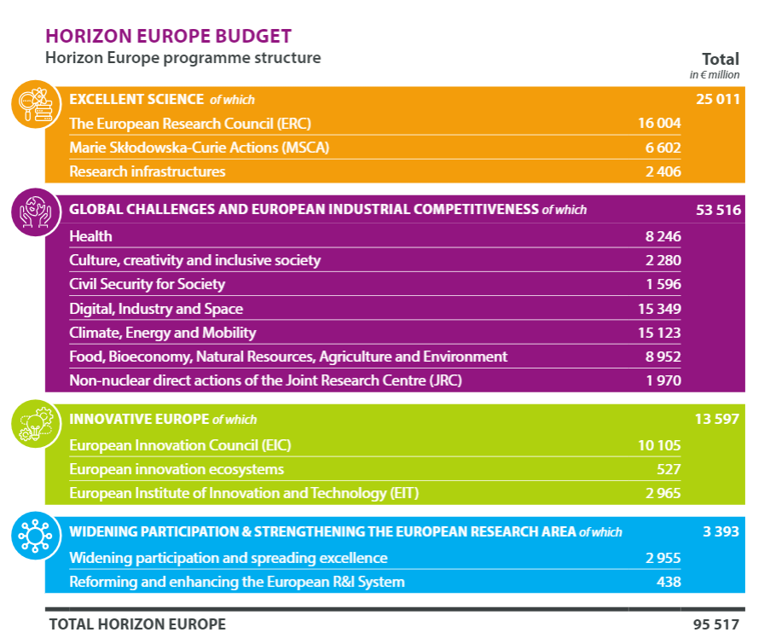
Budget allocation in Horizon Europe
Out of 13,473 projects in Horizon Europe, 629 are on societal engagement (4.5% projects, about 1-2% budget)
About €300m are invested in research infrastructure, about €5-10 are invested in citizen science
Despite this, citizen science is the area of open science with the strongest evidence of impact

Slide 33
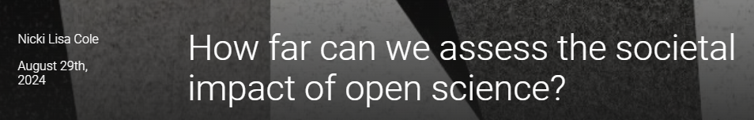
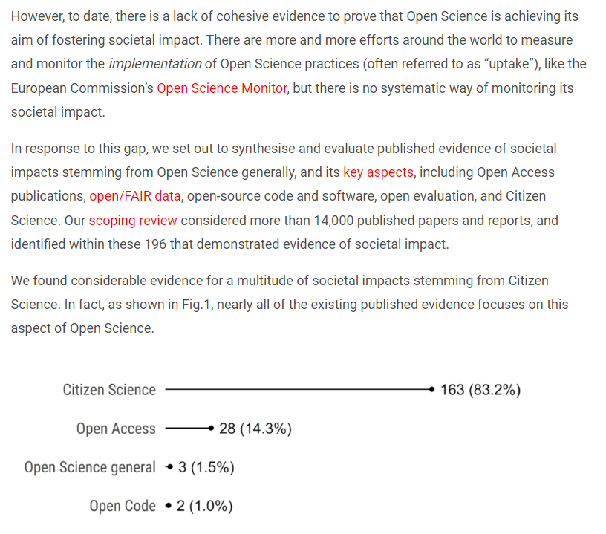

Slide 34
A place for citizen science
Open science raised a lot of issues with the daily operation of science: managing data, publishing, software that is being used, practices of sharing resources
All these do not change the fundamental process of scientific research – the workflow, lab experiments, or authorship practices remain mostly unchanged
Citizen science and participatory research require more than this…

Slide 35
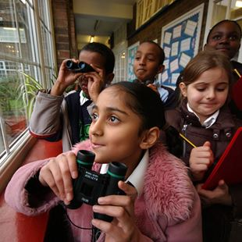
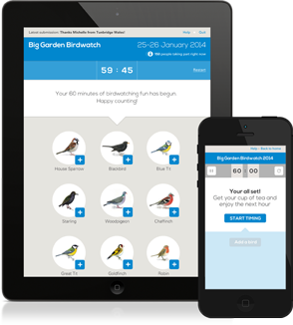
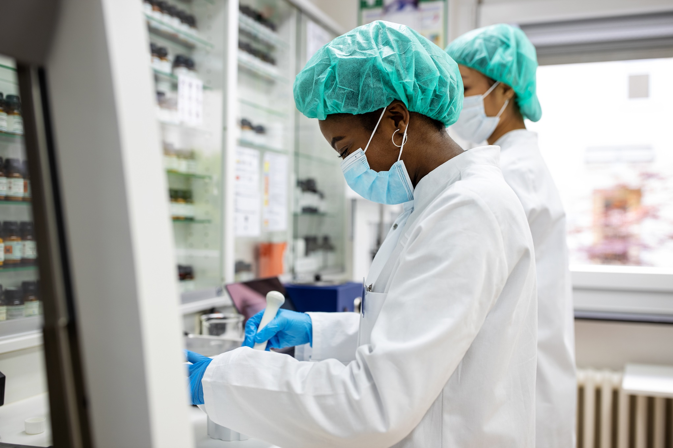
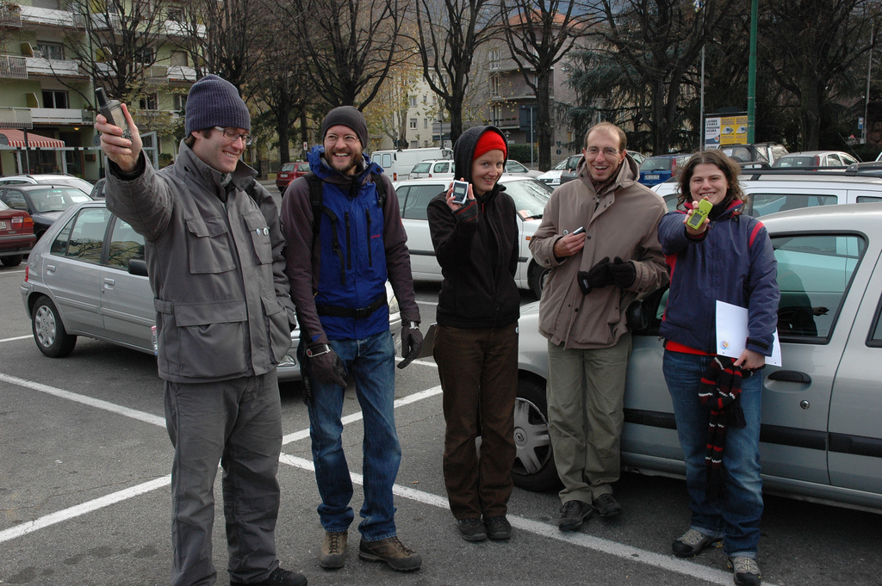
Scarcity
Abundance
Participating in Big Garden Birdwatch (source: RSPB)
(c) Andrea Antonello

Slide 36
Scarcity
  Investment in training
  Maximising output from each action
  Top-down, standarised procedures to ensure ‘once & good’ – optimisation
  Standard equipment and software
Abundance
  Assumption of variable skills and training
  Ensuring microtasks are enjoyable and rewarding
  Multiplicity of procedures and interactions to ensure engagement
  Multiplicity of equipment with limited information about characteristics
(c) Ordnance Survey

Slide 37
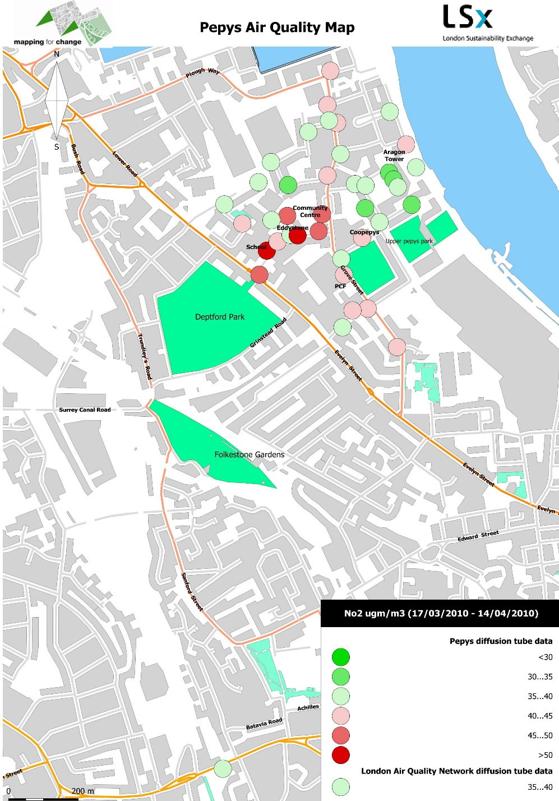
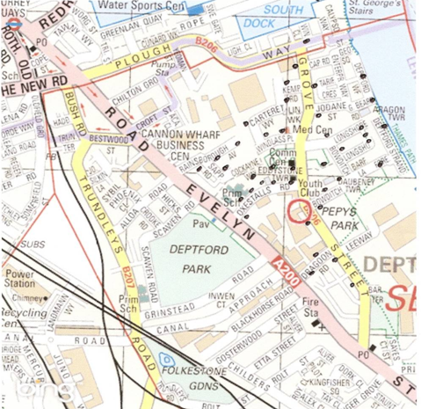
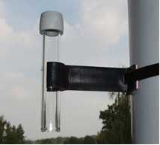

Status anxiety plays an important role in institutional resistance

Slide 38
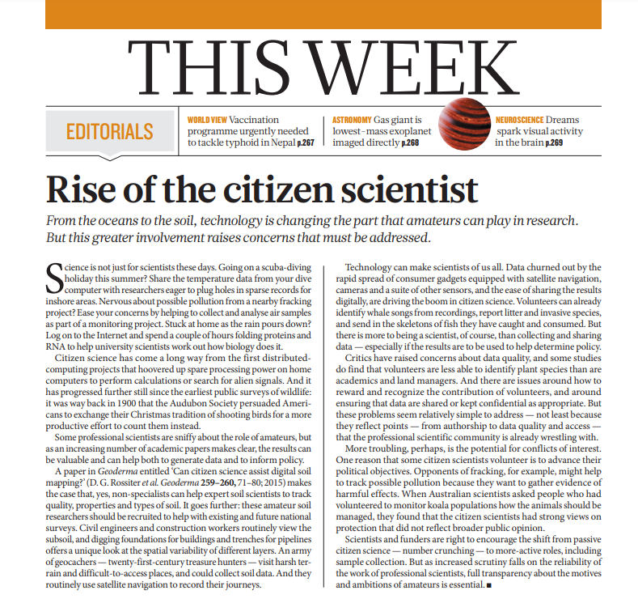
“Disinterested science” is causing concern about activism
The Mertonian norms: communism, universalism, disinterestedness, organised skepticism.
They created the imaginary disinterested science, hence issue with activism
Motivations impact all science, not just citizen science. Citizen science is, in a way, more honest by being open about its interests
Notes:
More troubling, perhaps, is the potential for conflicts of interest. One reason that some citizen scientists volunteer is to advance their political objectives. Opponents of fracking, for example, might help to track possible pollution because they want to gather evidence of harmful effects. When Australian scientists asked people who had volunteered to monitor koala populations how the animals should be managed, they found that the citizen scientists had strong views on protection that did not reflect broader public opinion.

Slide 39
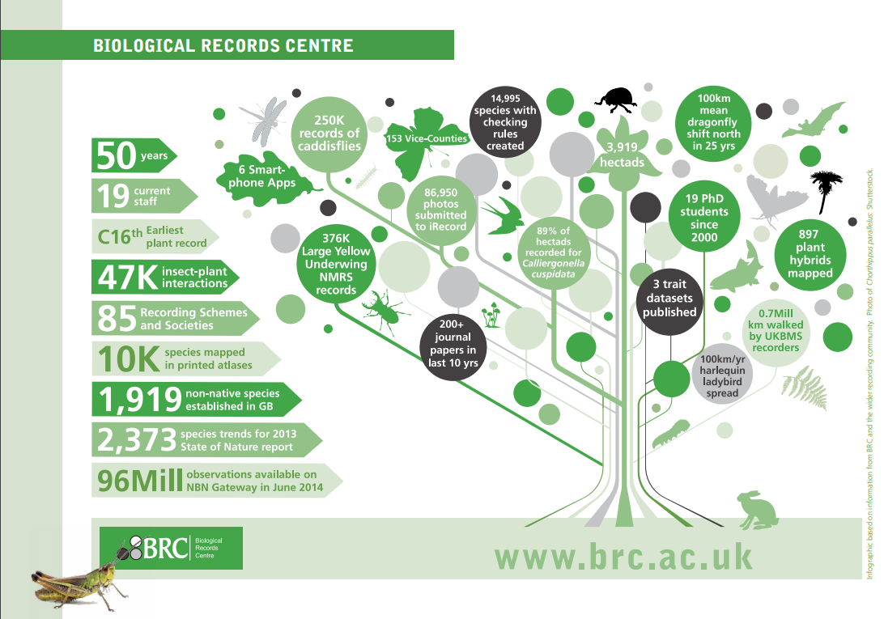
“expert in the loop” assist the acceptance
When scientists/experts act as intermediaries between citizen science projects and decision making/policy processes, it is more likely that the results will be used

Slide 40
Growing recognition across scientific fields

Slide 41
Societal benefits and return on investment
Citizen science provides a way to capitalise on the societal investment in increasing levels of education to high levels
It provides a way to gain access and engage the high number of people with high education who are outside the formal R&D system
Provide additional benefits and efficiencies at a national level

Slide 42
Institutional transformation – TIME4CS

Slide 43
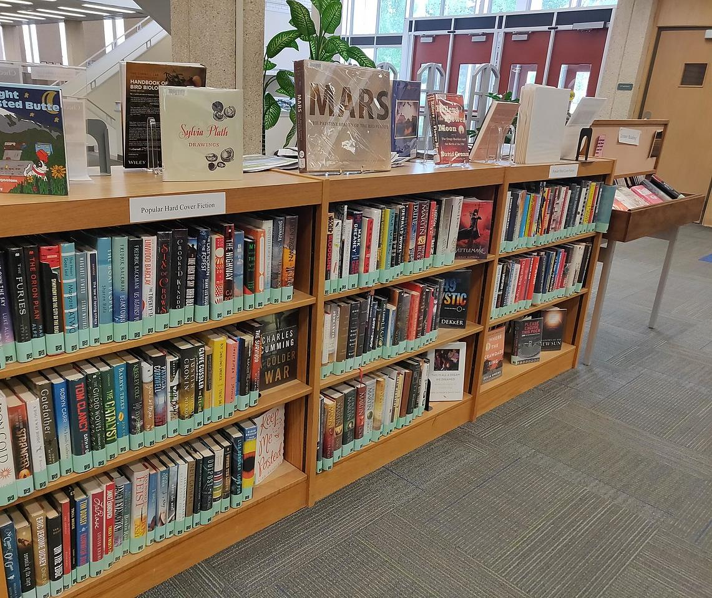
More resources
Discover, collaborate, explore: From theory to practice

Slide 44
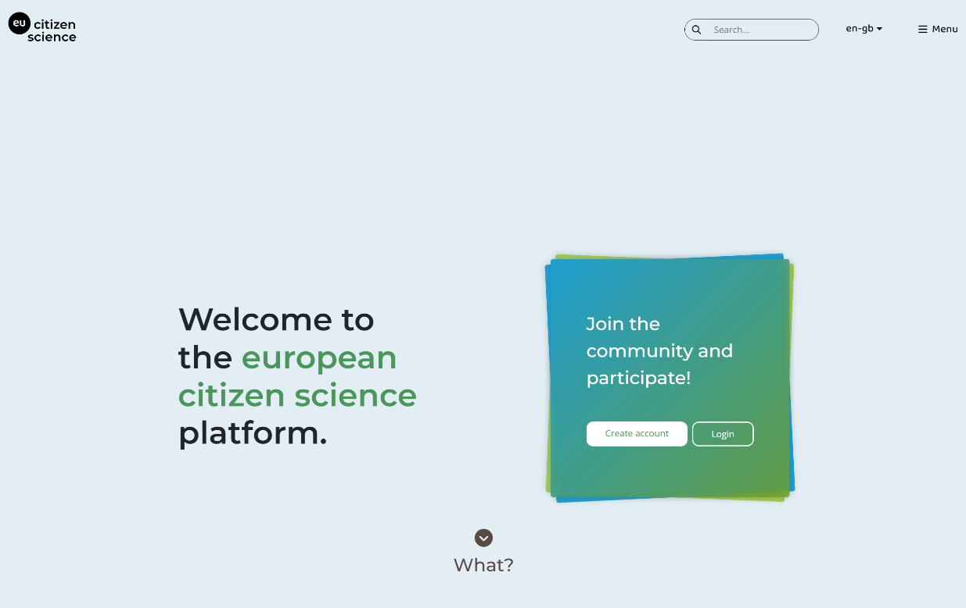



The platform to share, initiate
and learn
citizen science
in Europe
https://eu-citizen.science

Slide 45

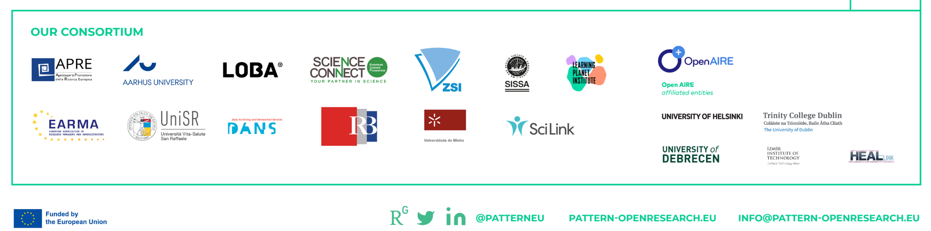

Slide 46



Notes:
Last year, public television in the USA broadcasted a programme dedicated to citizen science, which you can watch online.

Slide 47



Slide 48

Growing opportunities to learn…
Marie Curie Alumni Association – network of researchers
ECS project network of educators and trainers
ECSA working groups and activities

