Slide 1
Broad Engagement for Science
Broad Engagement in Science: The BESPOC Model
CC-BY-ND 2024 | Dr Tiberius Ignat | SKS Knowledge Services
Notes:
Hello, everyone. Thank you for inviting me …..
My name is Tiberius Ignat, and I am the director of SKS Knowledge Services.
We will talk today about how Researchers and how their organisations could build engagement with Society at large →

Slide 2
Credit: in this presentation, all ideas are man-made while some images are AI-made
Notes:
In this presentation, all ideas are man-made, while some images are AI-made.→

Slide 3
Science Engagement: A Very Short Introduction
Notes:
Let’s start with a very short introduction to what Science Engagement means →

Slide 4
Engagement Perspectives: Education and Research
Engagement for Education:
Promoting education and recruiting students
Enhance the learning outcomes
Build partnerships and collaborations
Promote lifelong learning
Cultivate civic engagement
Engagement for Research:
Promote and transfer new knowledge
Create impact through evidence-adoption
Adopt Research agenda to Society’s needs
Promote participatory science
Build partnerships and recruit support
BESPOC
(Broad Engagement in Science, Point of Contact)
Before
During
After
Notes:
Two strands: Engagement for Education and Engagement for Research.→
Universities traditionally engage with the public to enhance their educational missions. They aim to recruit diverse and talented students, enrich learning experiences with practical applications, and build meaningful partnerships, such as internships and knowledge exchange. Also, promoting lifelong learning and cultivating educational engagement are essential in advancing their mission as higher educators. In terms of education, the purpose of a university for engaging with the public is clear, and it’s not the topic of this presentation. →
But what about the need for universities to engage with the public on their research mission? Universities must engage with society to ensure their research advances knowledge, addresses real-world challenges, and prepares societies to accommodate changes. They meet societal needs by promoting and transferring new knowledge and creating impactful solutions through evidence adoption. Engaging the public in participatory science fosters a deeper connection and understanding. Building partnerships strengthens support for change and enriches research agendas. This playbook is essential for fulfilling the research mission of universities. I am sure you are convinced about that when you work pre-award to write the “impact” sections and post-award, to reach impact. Yet, not all universities are ready to embrace this complexity. Now it’s time to support this change towards what we call Engaged Research. →
BESPOC is a model addressing that: Public Engagement for Research! (02:30)→

Slide 5
Horizon Europe support for citizen engagement
Citizen engagement is about - the co-design of research agenda, - co-creation of research contents, and - co-assessment of research and innovation with citizen and civil society.
https://european-research-area.ec.europa.eu/horizon-europe-support-citizen-engagement
Notes:
The European Commission explains what kind of public engagement it expects. As we will see, public engagement is becoming serious business for the Commission, but how to do it? Willingness is not enough; support services for researchers are needed.
In the Commission’s words, Citizen engagement is about co-designing the research agenda, co-creating research content and co-assessing research and innovation outcomes with citizens and civil society. Involving citizens and civil society in research will ensure that the processes and results align with society's values, needs and expectations, improve the quality of research, the effectiveness of funding and its impacts, and help foster trust and understanding between science and society. →

Slide 6
Why to Engage (Research and Society)?
We must break down the barriers between research and innovation and wider society. We must engage widely to build shared understanding between those who consider themselves to be part of the research and innovation system and those who do not.
Ottoline Leyser, Chief Executive,
UK Research and Innovation
https://www.publicengagement.ac.uk/introducing-public-engagement
Notes:
Over the channel, the UK Research and Innovation is playing the same tune: “engage widely to build shared understanding” between researchers and the rest of society. (1:00 | 3:30)→

Slide 7
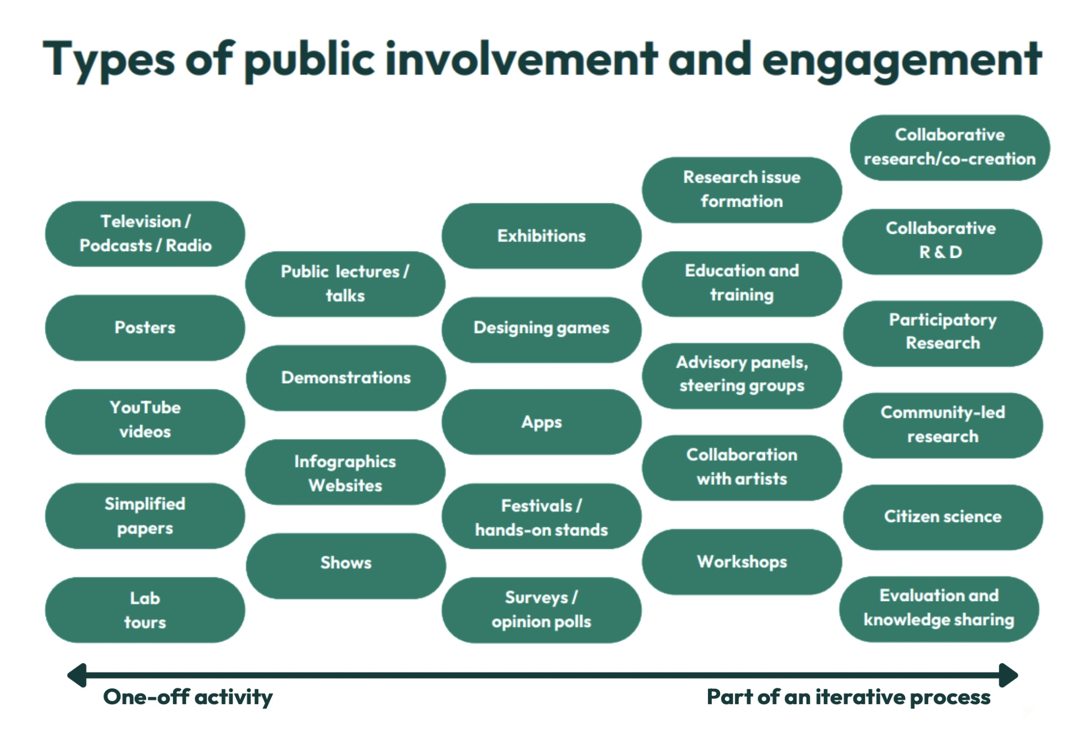
Credit: University of Exeter
Notes:
But let’s examine how complex Public Engagement in Research is. Let’s call it Engaged Research. It’s easier this way.
Engaged research is a two-way process that recognises and values the expertise, skills, and knowledge of non-academics. It encompasses the different ways researchers meaningfully interact with other partners throughout the research process, enabling the co-creation of research questions and shared delivery of research. Partners could include user communities, members of the public, private companies, or non-governmental organisations.
As we see here, Engaged Research spans from one-off activities to complex, iterative processes. Participatory science is a complex, iterative process. But it’s not the only one! For example, collaboration between researchers and artists could be an equally valuable piece of Engaged Research! Reach out if you’d like to discuss more! →

Slide 8
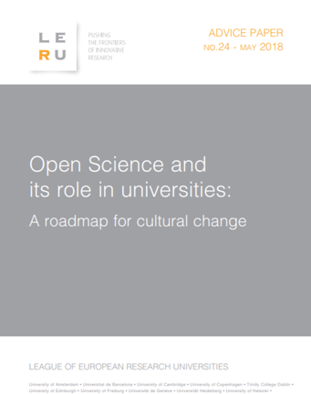
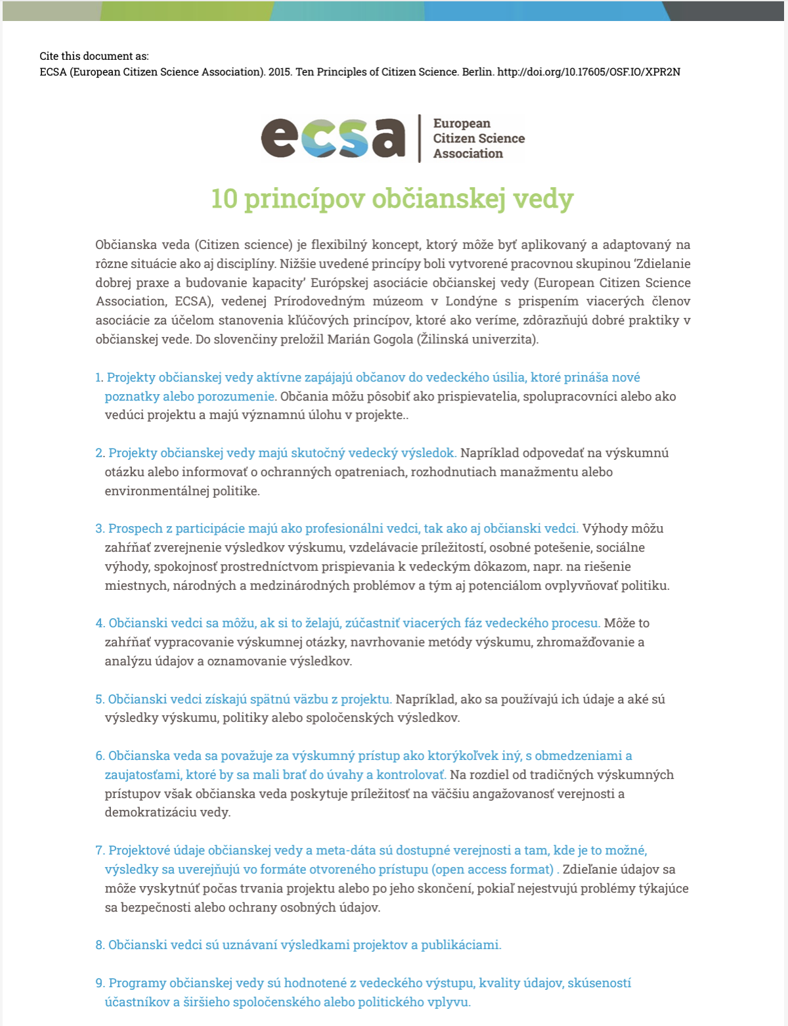
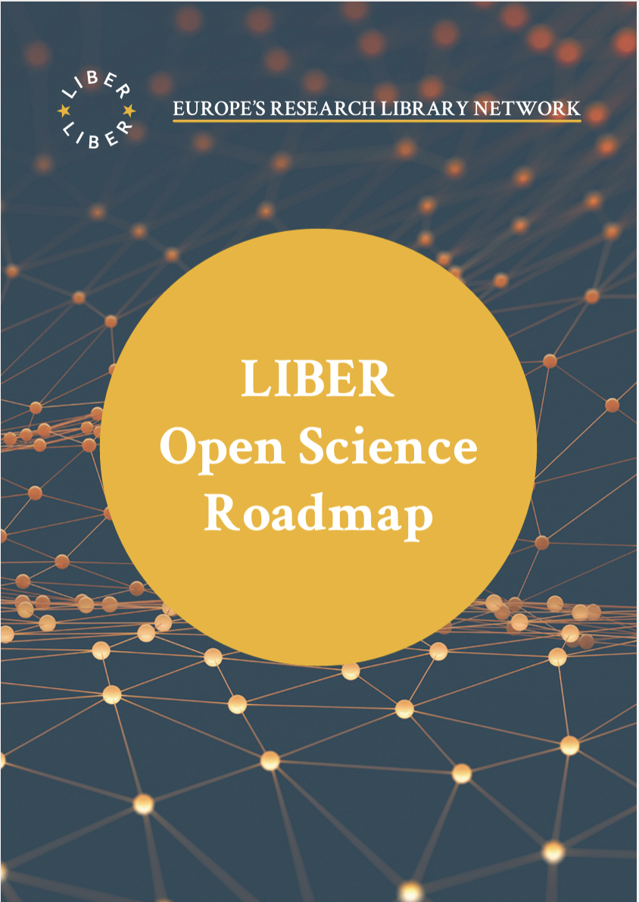
Open Science, Citizen Science, Public Engagement in Research
Notes:
Many organisations advocate for Open Science, Citizen Science and even Engaged Research. I am sure many of you are already familiar with it, but I wanted to highlight a few Principles, Recommendations, and Roadmaps available to you. Don’t be overenthusiastic! Coming up with these nice and thoughtful documents is an academic routine. Their implementation is less so. So, if we like these principles, recommendations, and roadmaps – I find beauty in them - let’s all turn to our own organisations and see what we can do to make reality. These associations, funders and international organisations will not implement them for us. They show us a way. But it’s us driving the car on that journey. (1:15 | 5:45)→

Slide 9
Open Science / Participatory Science Where are we, really?
Notes:
All right! Open Science and Participatory Science. Where are we, really?→

Slide 10
No man ever steps in the same river twice, for it's not the same river and he's not the same man.
Notes:
Let’s remind ourselves about Heraclitus of Ephesus: “No man ever steps in the same river twice, for it's not the same river, and he's not the same man”.→

Slide 11
There is nothing permanent except change.
Notes:
…And he meant “Change.” Nothing is permanent except Change. A new cycle begins for Europe and for the world. (Pause). Open Science thrived in a globalised world committed to collaboration on issues like climate change, space and health. Those times are over. Now, we witness the change. Our world is transforming under protectionism, restricted mobility, and manipulated communications. Unfortunately, the geopolitical agenda pushes research and participation in science down the priority list, but we are determined to continue our efforts.→

Slide 12
The EU MISSION LETTER Ursula von der Leyen, President of the European Commission to Ekaterina Zaharieva, Commissioner-designate for Startups, Research and Innovation
There is nothing permanent except change.
…the spirit of the Political Guidelines which I presented to the European Parliament in July 2024 - our common plan for European strength and unity. It focuses on ensuring our security in every sense in a more dangerous and turbulent world, on supporting people and citizens by strengthening our prosperity, our social market economy, green and digital transitions and sustaining our unique quality of life. We will strengthen our democracy, rally around our values and ensure that we are stronger at home. We will work with our partners and better assert our interests around the world.
I would like you to work to strengthen our research security. While promoting the development of critical technologies and their deployment in the European Union, you will be mindful of the need to safeguard our Union's economic security while partnering with like-minded partners to achieve common objectives. In this context, you will contribute to the work on identifying and harnessing the EU's dual-use and civil-military potential.
﻿I would like you to lead the work on reinforcing international research and innovation cooperation to better address EU dependencies in strategic sectors while promoting our values and principles. You will work to identify partners for cooperation in critical technology areas, notably through Global Gateway projects.
Notes:
In the latest mission letter from President Ursula von der Leyen to Commissioner-designate Ekaterina Zaharieva, we see a shift in focus for the new mandate. Unlike past priorities, which emphasised open science, this mandate strongly emphasises research security. The directive highlights the need to safeguard the EU’s economic security while developing critical technologies and identifying strategic international partners. Notably, the letter underscores the importance of addressing EU dependencies in strategic sectors through secure cooperation and prioritising research that aligns with EU values. This shift reflects a broader focus on protecting European interests in an increasingly turbulent global landscape. →

Slide 13
The EU MISSION LETTER Ursula von der Leyen, President of the European Commission to Ekaterina Zaharieva, Commissioner-designate for Startups, Research and Innovation
There is nothing permanent except change.
Participatory science receives support, but in a different way: co-creation.
The Mission Letter reads:
This Commission will start a new era of dialogue with citizens and stakeholders.
You should organise a first edition of the annual Youth Policy Dialogues within the first 100 days so that young people can be heard and can help shape your work.This will be part of our work in embedding citizen participation in our work. We will build on the Conference on the Future of Europe to instil a true and lasting culture of participative democracy.
We will choose policy areas and proposals where recommendations from a European Citizens' Panel would have the greatest value and follow up on their proposals.
Notes:
The only notable element of Open Science that remains on that mission letter is Participatory Science: particularly, it offers support for co-creating Europe’s research priorities and envisions participatory science to instil a true and lasting culture of participatory democracy in Europe. →

Slide 14
The proof of the pudding is in the eating…
Notes:
As people say, “The proof of the pudding is in the eating…”. (2:15 | 8:00)→

Slide 15
The Way to BESPOC
Notes:
[The Way to BESPOC]. First, let’s talk about motivation. We are a mission-driven organisation. I keep repeating that, no matter how hard it is for people to believe it. Private companies like ours are usually put in the same pot with big, multinational companies and are met with a certain suspicion by the public. But we stand for our mission, no matter if we can convince people now or only later. Our mission is to make research more popular →

Slide 16
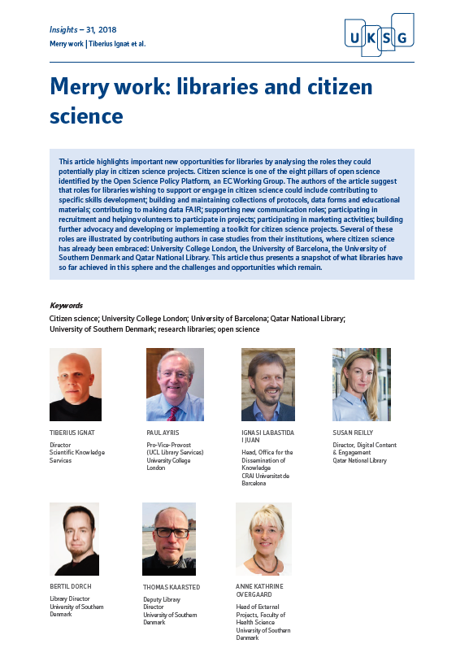
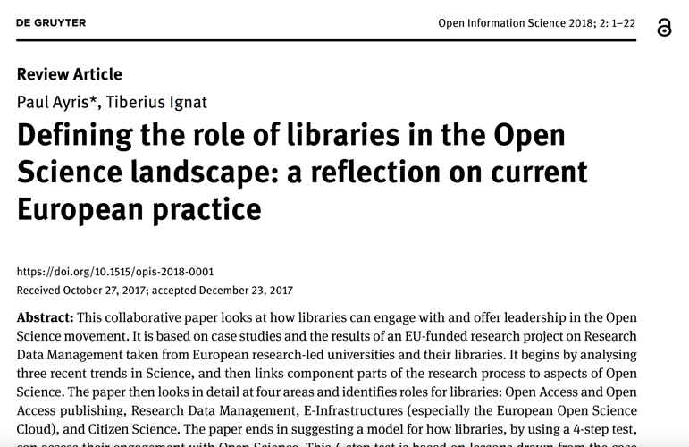
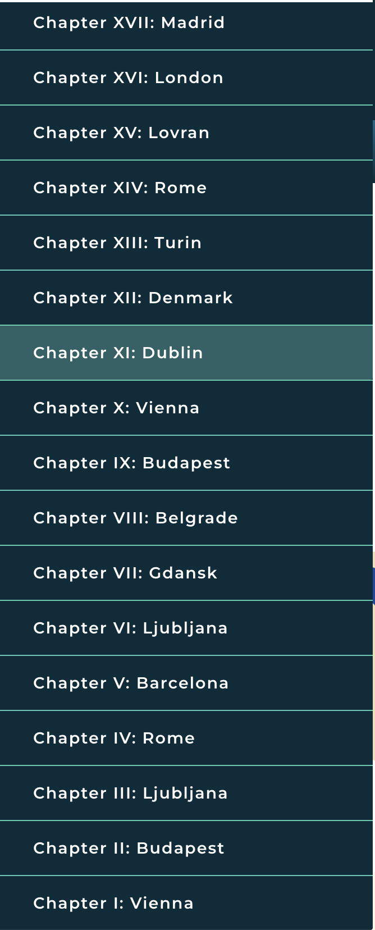
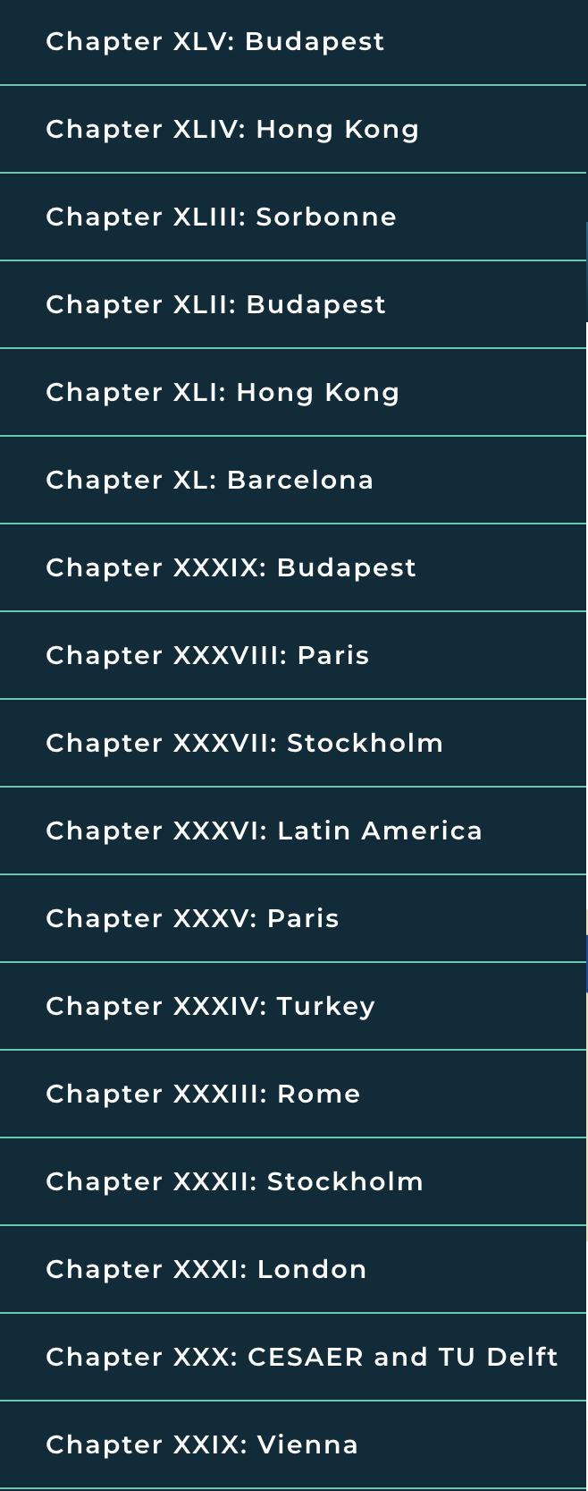
Advocating for Open Science
doi.org/10.1515/opis-2018-0001.pdf
doi.org/10.1629/uksg.431
www.scholarly.events
Notes:
[Advocating for Open Science]. At the beginning, it was an advocacy programme for Open Science. We started a series of events in 2015 called Focus on Open Science, with its inauguration here in Ljubljana. We have organised 48 events in 10 years, the latest being a month ago in Budapest. We organised such events from Dublin to Hong Kong and from Korsør in Denmark to Barcelona, going through Stockholm, Paris, London, Ljubljana, Vienna, Rome, and many other places. Also, together with colleagues from European universities, we contributed to growing the culture of participatory science at universities, particularly by positioning the research libraries as active supporters of citizen science. →

Slide 17
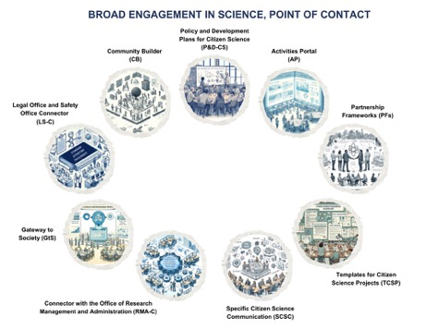
The BESPOC Prototype
The BESPOC Prototype
(Broad Engagement in Science, Point of Contact)
Ignat, T. and Ayris, P. (2020) ‘Built to last! Embedding open science principles and practice into European universities’, Insights: the UKSG journal, 33(1), p. 9. Available at: https://doi.org/10.1629/uksg.501.
Notes:
[The BESPOC Prototype]. Then, in 2020, I published a paper with Dr Ayris, the pro-vice-provost of UCL. In it, we envisioned how to embed open science principles for long-lasting at European Universities. In that paper, I first described the BESPOC prototype for engaging the public in research activities, a framework that includes but is not limited to citizen science→

Slide 18
BESPOC Prototype (2018-2020)
Notes:
[BESPOC Prototype (2018-2020)] The prototype was developed between 2018 and 2020 and published open access in UKSG Insights, a reputable publication from the UK Serials Group.→

Slide 19
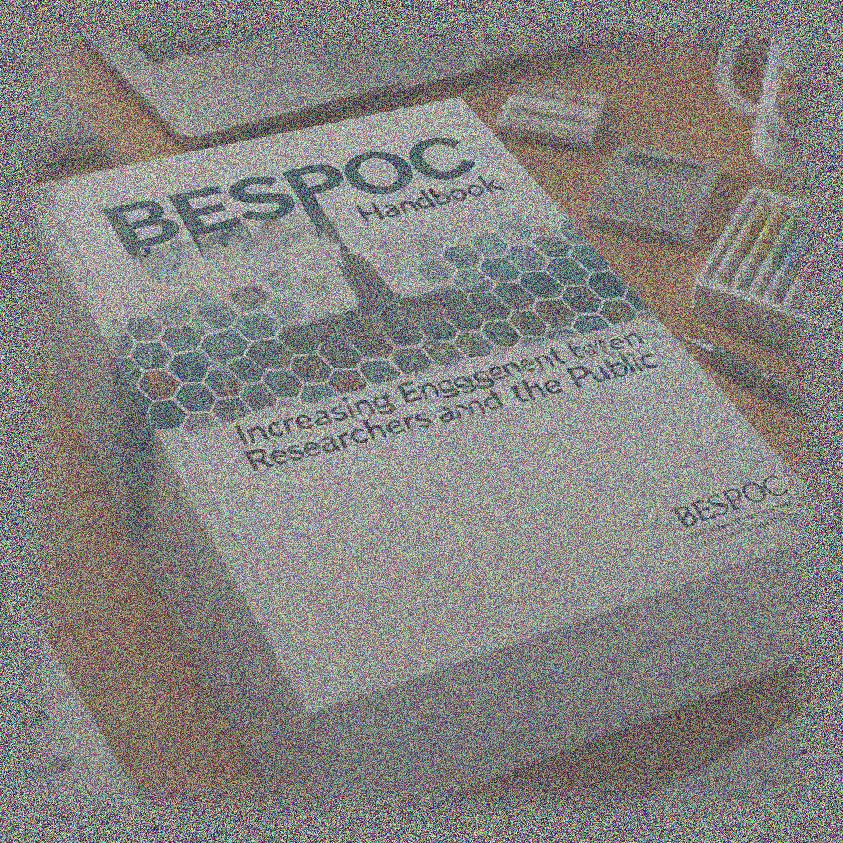
BESPOC Prototype
> BESPOC Model
1st version: 2022
Notes:
[BESPOC Prototype (2018-2020) to The BESPOC Model]. We developed the prototype further, evolving it into an implementation model. Its first version was ready in 2022. (3:00 | 11:00)→

Slide 20
The Experience we used to create the BESPOC Model
Notes:
What informed us in making the BESPOC Model? →

Slide 21
Project Leader (EU Funded via EOSC)
R&D for The BESPOC Model
RESEARCH LIBRARIES,
RESEARCHERS & THE EOSC
Recommendations for EOSC Association
Recommendations for Research Libraries
Recommendations for other Research Stakeholders
Notes:
[Project Leader (EU Funded via EOSC)]. We led a project in 2021 that produced recommendations for the EOSC Association, recommendations for research libraries, and recommendations for other research stakeholders. We learned there, among other things, about the need for participatory science and the challenges related to data collected this way →

Slide 22
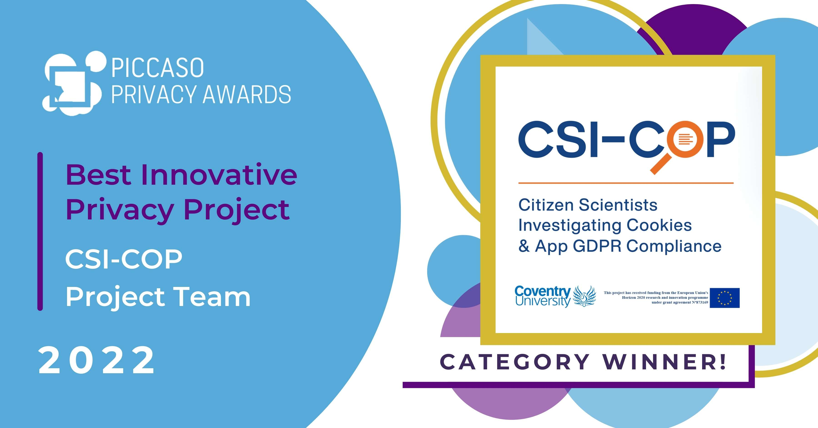
Project Partner (Horizon Europe)
R&D for The BESPOC Model
Citizen Scientists Investigating Cookies and App GDPR Compliance
1st Place Piccaso Privacy Awards, London 2022
Educated, tested and trained 600+ candidates;
Managed 180+ selected volunteers;
Changed behavior;
Informed policymakers.
Notes:
[Project Partner (Horizon Europe)]. We participated as a partner in a large citizen science project, Investigating Cookies and App GDPR Compliance. Our project was awarded 1st Place in the Piccaso Privacy Awards, London 2022, competing against the UK‘s Information Commissioner Office, Price Waterhouse Cooper, and many other great organisations. In this project, we educated, tested and trained over 600 candidates; we managed 180+ selected volunteers; Changed behaviour for online activities; and Informed policymakers.→

Slide 23
Project Partner & Consultant (Erasmus+)
R&D for The BESPOC Model
University Libraries Strengthening the Academia-Society Connection through Citizen Science in the Baltics
90-point Erasmus+ Evaluation
Implemented 5 BESPOC Models;
300 hours consultancy to senior university management, researchers, research managers and librarians;
Institutional changes.
Notes:
[Project Partner & Consultant (Erasmus+)]. We implemented 5 BESPOC Models. 300 hours of consultancy for senior university management, researchers, research managers, and librarians. We produced concrete institutional changes. This project was evaluated when we closed it at 90 points out of 100 by the Erasmus+ team. →

Slide 24
Founder and Chairing Working Groups
R&D for The BESPOC Model
LIBER Citizen Science Working Group (2019-2025)
ECSA Citizen Science at Universities (2020-2022)
Member of Academic Organizing Committees
Sorbonne Declaration of Research Data Rights (2018-2020)
OAI CERN-Uni.Geneva Workshop on Open Science (2018-present)
EARMA Open Science Thematic Group (2023-present)
Notes:
Further experience: I am the founder, and I was the chair of 2 Working Groups: LIBER Citizen Science Working Group (2019-2025) and ECSA Citizen Science at Universities (2020-2022). Member of Academic Organizing Committees: Sorbonne Declaration of Research Data Rights (2018-2020), OAI CERN-Uni.Geneva Workshop on Open Science (2018-present), EARMA Open Science Thematic Group (2023-present).
We learned from all these experiences and continued improving the BESPOC model to make it easier to implement. (3:00 |14:00) →

Slide 25
Engaged Research: How to Get Started
Notes:
So, how to get started if you want your organisation to practice Engaged Research?→

Slide 26
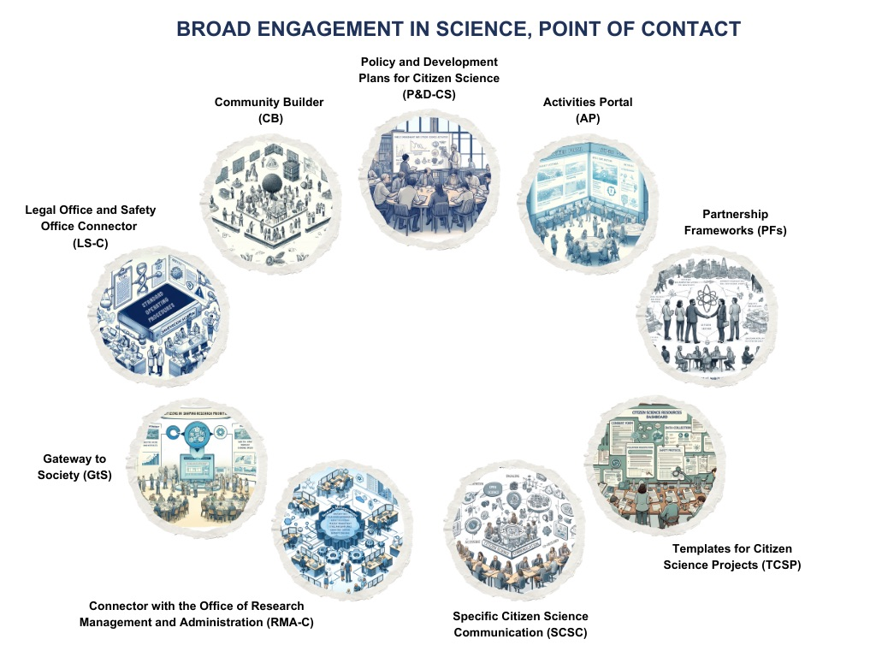
BESPOC Brief Presentation video: https://vimeo.com/870255373/2da1ea4990
https://vimeo.com/478021537
https://insights.uksg.org/articles/10.1629/uksg.501/
Notes:
Let‘s now go briefly through each of the BESPOC modules.→

Slide 27
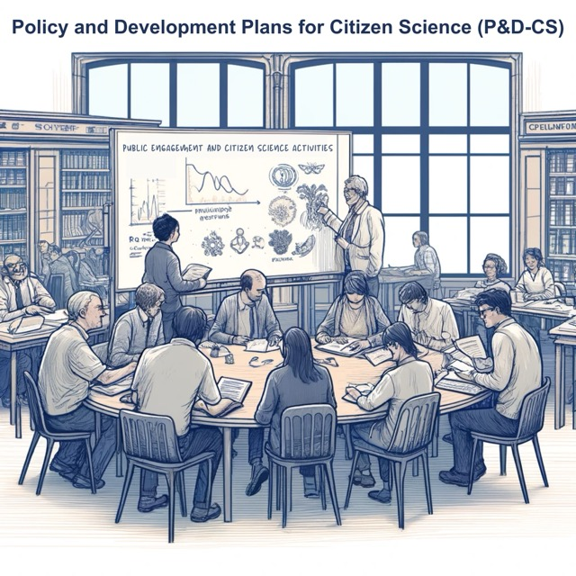
The BESPOC Model modules at a glance (1)
Policy & Development Plans (P&D-CS)
Supports the the development and periodic updating of policies specific to Engaged Research;
Institutionalize these practices within academic settings;
Effective communication and engagement of these policies across the institution.
Notes:
Policy & Development Plans. This module focuses on developing and periodically updating policies specific to Engaged Research and participatory science, aiming to institutionalise these practices within academic settings. It ensures the effective communication and engagement of these policies across the institution.→

Slide 28
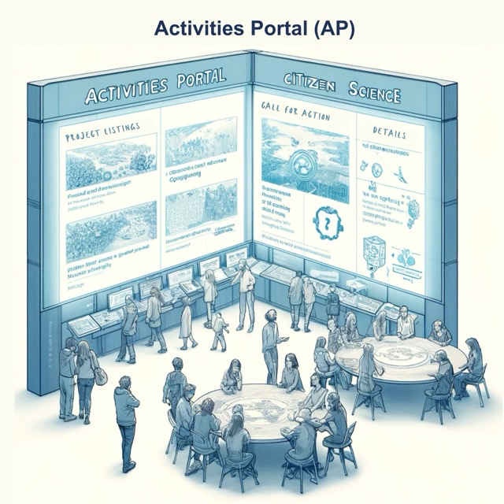
The BESPOC Model modules at a glance (2)
Activities Portal (AP)
Facilitates the transformation of policies into actionable projects and campaigns;
Project engagement, dissemination, and collaboration.
Notes:
Activities Portal. Acting as a central hub, the Activities Portal facilitates the transformation of policies into actionable projects and campaigns. It supports project engagement, dissemination, and collaboration, serving as a vital resource for citizen science endeavours.→

Slide 29
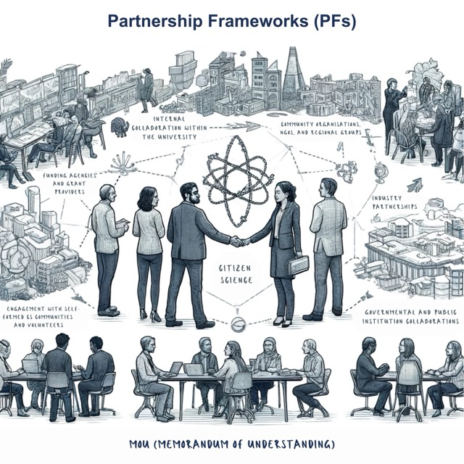
The BESPOC Model modules at a glance (3)
Partnership Frameworks (PFs)
Frameworks for collaborative relationships with various stakeholders;
Enhances the impact of Engaged Research both in academia and in broader society.
Notes:
Partnership Frameworks. BESPOC emphasises establishing collaborative relationships with various stakeholders, outlining these partnerships' structure, roles, responsibilities, and objectives. This framework enhances the impact of participatory science both in academia and in broader society.→

Slide 30
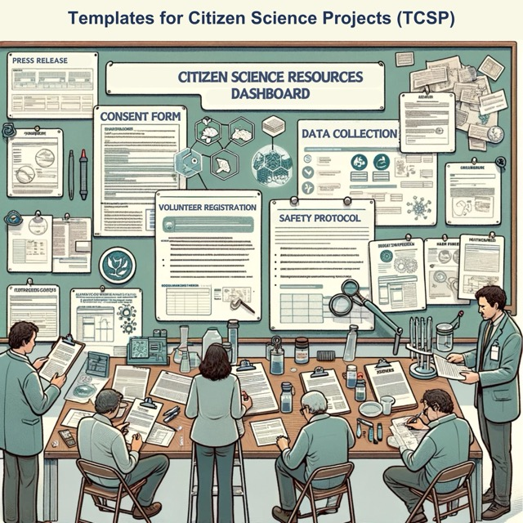
The BESPOC Model modules at a glance (4)
Templates for Participatory Science Projects (TPSP)
Provides essential resources for initiating and executing participatory science and practice Engaged Research;
Includes consent forms, data collection sheets, and safety protocols, ethical compliance tools, effective communication templates, and many more.
Notes:
Templates for Participatory Science Projects. This resource provides essential (almost) ready-to-use resources for initiating and executing participatory science projects. It includes consent forms, data collection sheets, safety protocols, ethical compliance tools, effective communication templates, and more. (Pause). Spoiler alert! At SKS, we also want to enable a community-driven BESPOC Repository to start sharing such templates!→

Slide 31
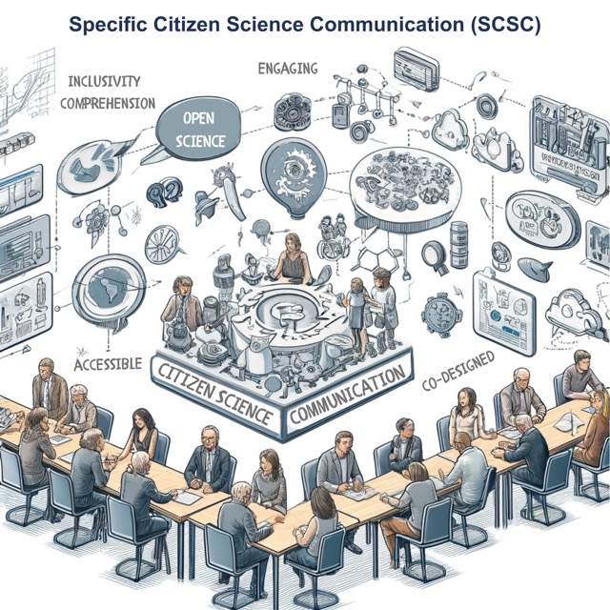
The BESPOC Model modules at a glance (5)
Specific Engaged Research Communication (SERC)
Address the unique challenges of communicating complex research to non-professionals;
Promotes accessibility, engagement, and two-way communication;
Fostering transparency and adherence to OS principles.
Notes:
Specific Engaged Research Communication. This module addresses the unique challenges of communicating complex research to non-professionals. It promotes accessibility, engagement, and two-way communication, fostering transparency and adherence to OS principles.→

Slide 32
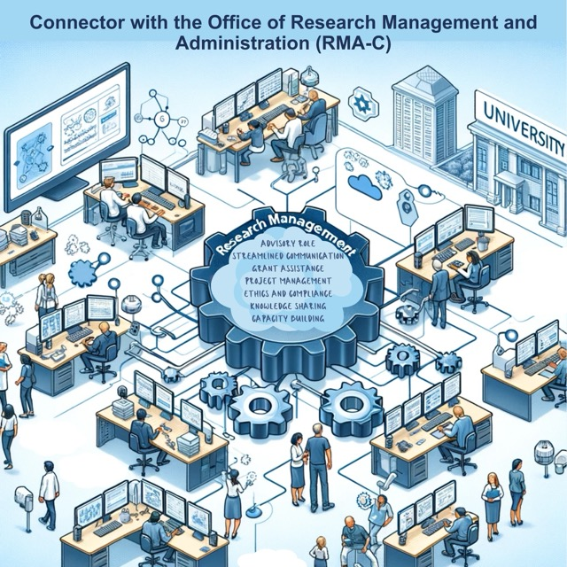
The BESPOC Model modules at a glance (6)
Research Management & Administration Connector (RMA-C)
Integrates CS activities with existing research management systems and offices,
Notes:
Research Management & Administration Connector. This connector integrates CS activities with existing research management systems and offices, facilitating efficient workflows, policy integration, and enhanced support for citizen science projects within the institution.→

Slide 33
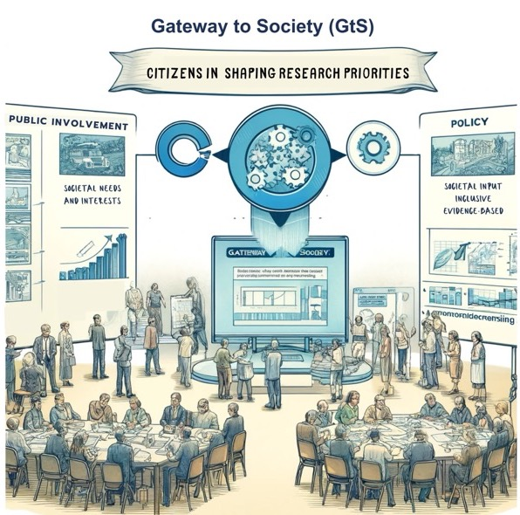
The BESPOC Model modules at a glance (7)
“This Commission will start a new era of dialogue with citizens and stakeholders.”
U. v. d. Leyen, President of the EC
Gateway to Society (GtS)
Population to contribute to shaping research priorities;
Ensures research findings inform policymaking;
Connects research activities with decision-making processes.
Notes:
Gateway to Society. It empowers the population to shape research priorities and ensure research findings inform policymaking. It strengthens the connections between research activities and decision-making processes. This module fits very well with President von der Leyen's mission letter to Commissioner Zaharieva. →

Slide 34
The BESPOC Model modules at a glance (8)
Legal & Safety Office Connector (LS-C)
Legal and safety compliance for Engaged Research.
Facilitates understanding and responses to legal and safety matters,
Safeguards participants, researchers, and the institution.
Notes:
Legal & Safety Office Connector. It ensures legal and safety compliance in participatory science projects and research engagement activities. It facilitates understanding and responses to legal and safety matters and safeguards participants, researchers, and the institution.→

Slide 35
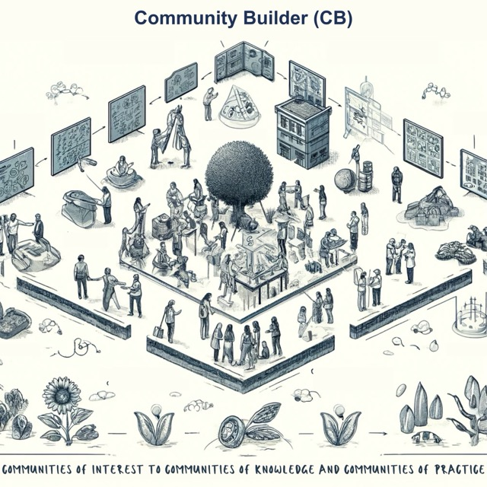
The BESPOC Model modules at a glance (9)
Communities Builder (CB)
Cultivates sustainable communities around Engaged Research.
Supports and develops Communities of Interest , Communities of Knowledge, and Communities of Practice..
Notes:
Finally, the Communities Builder. Focused on cultivating sustainable communities around Engaged Research (well-maintained bridges beyond projects). It supports the development of and the transition from Communities of Interest to Communities of Knowledge and to Communities of Practice, encouraging personal and collective growth within these communities.(6:00 | 20:00)→

Slide 36
Example of BESPOC Implementations
Notes:
Let’s look at some examples of BESPOC Implementations.→

Slide 37
BESPOC Implementations in the Baltic Region
Erasmus+ KA2 Strategic Partnerships program
Project number: 2021-1-EE01-KA220-HED-000031125
Notes:
To illustrate this, I am using the example of the BESPOC implementation in the Baltic Region (Estonia, Latvia, and Lithuania).→

Slide 38
LibOCS | Project Overview
LibOCS: University libraries strengthening the academia-society connection through citizen science in the Baltics
Duration: 01.01.2022 –30.06.2024
Academic partners: University of Tartu Library, TalTech, University of Latvia, Kaunas Technological University, Vytautas Magnus University
https://www.libocs.ut.ee
Notes:
A few words about the LibOCS project, which offered the financial means for the BESPOC implementations. It was funded under the Erasmus+ framework. It started in January 2022 and finished in June 2024. Led by Tartu University Library in Estonia, it involved five academic institutions: the University of Tartu Library, TalTech, the University of Latvia, Kaunas Technological University, and Vytautas Magnus University. →

Slide 39
6 Activities + 2 Multiplier Events (9 Milestones)
ME5 Speaking BESPOC with Practitioners
(w. ECSA)
01.03.2024
Multiplier events
PR5A1
PRE-IMPLEMENTATION CONSULTATION AT BALTIC HEIs
Milestones 25, 26 (5 x 10h Consultation) +
(20 page analysis)
PR5A3
CONSULTANCY AND SERVICE DEVELOPMENT WORKSHOPS W.UNIs ( IMPLEMENTATION OF TAILORED MADE BESPOCs)
Milestone 28 (2 x5 x 20h Consultation)
PR5A5
FORWARD-LOOKING PAPER “PUBLIC-SCHOLARLY ENGAGEMENT IN BALTIC HEIs”
Milestone 30 (paper 10p)
ME6 Speaking BESPOC with Research Libraries
(w. LIBER)
30.03.2024
2023.10-2024.01
2024.02-2024.03
2024.05
2023.10-2023.12
2024.01-2024.03
2024.05
PR5A2
CURRENT ANALYSIS OF PRACTICES AT PARTICIPATING BALTIC HEIs
Milestone 27 (10 workshops)
PR5A4
INSTITUTIONAL CHANGE: REPORT ON ACHIEVEMENTS IN THE FIVE PARTICIPATING INSTITUTIONS
Milestone 29 (report 20p)
PR5A6
TRANSFERABILITY THROUGH INSTITUTIONAL AND POLICY CHANGE: FOCUS IN ESTONIA
Milestone 31 (paper)
Notes:
As you can see, the BESPOC implementation was contained in 6 large activities and communicated through 2 multiplier events that aimed to inspire other organisations.→

Slide 40
The BESPOC Implementation Methodology in LibOCS
Pre-Implementation Consultation and Analysis
Priority Setting and Custom Workshops
Comprehensive Module Implementation
Diverse Participant Recruitment
Collaborative Tools and Communication Platforms
Analytical Framework
05.06.2023 –
25.10.2023 – 01.03.2024
Notes:
The BESPOC implementation had two distinct phases: (1) the pre-implementation phase, which included consultations and state-of-play analysis and (2) the implementation phase, which included establishing each university‘s priorities and custom workshops, and recruiting diverse participants from the university management for contributing to the implementation. We then implemented the BESPOC modules, and we established an analytical framework to identify our impact.→

Slide 41
The BESPOC Implementation Score (1 to 10)
9,2
The LibOCS Project’s Final Evaluation Score (1 to 100)
90
Notes:
We proudly report that the BESPOC implementation received a 9.2 score on an internal evaluation, and the LibOCS (the project) final evaluation—by the ERASMUS+ experts—received 90 points out of 100. In fact, they interviewed the project leader, Liisi Lembinen, from Tartu University, to learn how we scored that high.→

Slide 42
Milestone 29: Citizen Science Institutional Change Through BESCPOC Implementations
[doi.org/10.5281/zenodo.10949874]
Implementation Process and Key Milestones
Institutional Changes Observed
Impact Assessment
Challenges and Future Steps
Conclusion
Notes:
I‘d like to highlight one of the project milestones: investigating the changes we affected by implementing BESPOC at these five universities. For this, we analysed the implementation processes and milestones we achieved, observed the institutional changes we triggered, assessed our impact, and identified the challenges and the next steps. All of these were wrapped in conclusions published in a report available in Zenodo under the displayed DOI.→

Slide 43
Milestone 29: Citizen Science Institutional Change Through BESCPOC Implementations
[doi.org/10.5281/zenodo.10949874]
The cross-institutional analysis recognized the unique specificity and priorities of each university.
The BESPOC implementation focused on valuing collaboration over competition, encouraging mutual support, sharing practices, and engaging in meaningful dialogue.
Notes:
The cross-institutional analysis that I mentioned recognised each university's unique specificity and priorities. The BESPOC implementation focused on valuing collaboration over competition, encouraging mutual support, sharing practices, and engaging in meaningful dialogue. This analysis was not used as an opportunity to compete or compare institutions. Rather, the opposite, we used it to share lessons learned during the BESPOC implementations.→

Slide 44
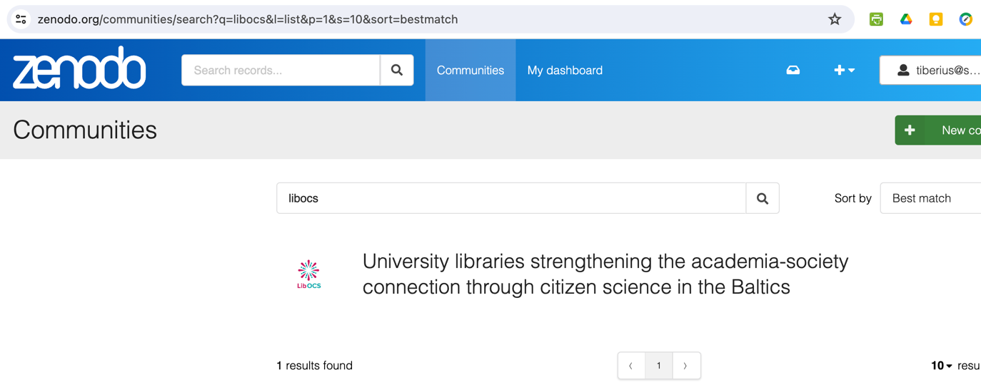
Follow us:
Zenodo collection:
University libraries strengthening the academia-society connection through citizen science in the Baltics | Zenodo
Notes:
You can access all our outcomes, including milestones, papers, and a five-module Self-Paced Training on Citizen Science at libraries, by going to our stand-alone Zenodo collection that we maintain as part of the project.→

Slide 45
The LibOCS Outcomes:
Website: https://www.libocs.ut.ee/
Facebook: https://www.facebook.com/LibOCSproject/
Youtube channel https://www.youtube.com/@LibOCSproject
X: (11) #LibOCS - Twitter Search / Twitter
Zenodo collection: University libraries strengthening the academia-society connection through citizen science in the Baltics | Zenodo
Notes:
Or, if you prefer this way, you can learn more about our work through these links. (5:00 | 25:00)→

Slide 46
Conclusions
Notes:
CONCLUSIONS →

Slide 47
An Engaged Researcher
Engages with their organisation policy and your organisation policymakers;
Engages with their own research activity and with other research activities in their university;
Engages with external partners;
Engages with existing resources (templates, check-list); contribute maintaining and updating them;
Engages in specific communications accessible and resonating with the public;
Engages with the resources available for you in the Research Office (Grant Office, etc);
Engages with the broad society for learning about their priorities, co-create with them, create synergy and translate results into actionable items (public policies, petitions, engineering, public experiments, etc);
Engages with their legal and safety departments; newly, also with the research security officers;
Engages continuously with the communities relevant for them (whether they contributed to form them or not) and support their journeys from Communities of Interest, to Communities of Knowledge, to Communities of Practice.
Ask yourself:
Could someone do all that alone, or do they need a service that has the necessary competence and capacity to help them?
Notes:
What is an Engaged Researcher? What should such a researcher do on top of the obvious research activities?→
He or she, engages with their organisation policies and policymakers→ Engages with their own research activity and with other research activities in their university→Engages with external partners→Engages with existing resources (templates, check-list); not only to benefit from them (use them) but also to maintain and update them→Engages in specific communications accessible and resonating with the public→Engages with the resources available for them in the Research Office (Grant Office, etc) →Engages with the broad society for learning about their priorities, co-create with them, create synergy and translate results into actionable items (public policies, petitions, engineering, public experiments, etc) →Engages with their legal and safety departments; newly, also with the research security officers→Engages continuously with the communities relevant for them (whether they contributed to form them or not) and support their journeys from Communities of Interest, to Communities of Knowledge, to Communities of Practice. →
Now, ask yourself: Could someone do all that alone, or do they need a service with the necessary competence and capacity to help them? If the answer is no, and you believe the Engaged Researcher is what you’d like to achieve, then it’s time to start supporting your researchers in such a journey →

Slide 48
To make an impact…
… practice Engaged Research!
Notes:
We make This call by promoting BESPOC: “Make an impact, and practice engaged research!→

Slide 49
Together, we can make Research a popular culture!
Increase research quality and impact!
Enhance research with engagement, not with quantity!
What will researchers leave behind?
“Publish or Perish” Culture
Salami science
Research without purpose
Engaged Research could also help institutions attract new support for their educational programmes.
Notes:
Our BESPOC Model is an invitation to increase research quality and impact and enhance research with engagement, not with quantity! → What will researchers leave behind? The “Publish or Perish” Culture. Salami science. Research without purpose. →As a collateral, Engaged Research will help institutions attract new support for their educational programmes. →Together, we can make Research a popular culture! This is our mission at SKS. Even if we are a private company and for some, it is hard to believe it, we are driven by this mission: “Make Research a Popular Culture”→

Slide 50
Thank you!
Dr Tiberius Ignat
orcid.org/0000-0002-4839-2344
www.linkedin.com/in/tiberiusignat
https://crowdhelix.com/public-profile/18080
CC-BY-ND | 2024 | SKS Knowledge Services
Notes:
Now it’s for real. I finished it. If you’ve been listening to it, thank you, and I look forward to hearing your questions! (Extra 6:00)→

